Slide 1
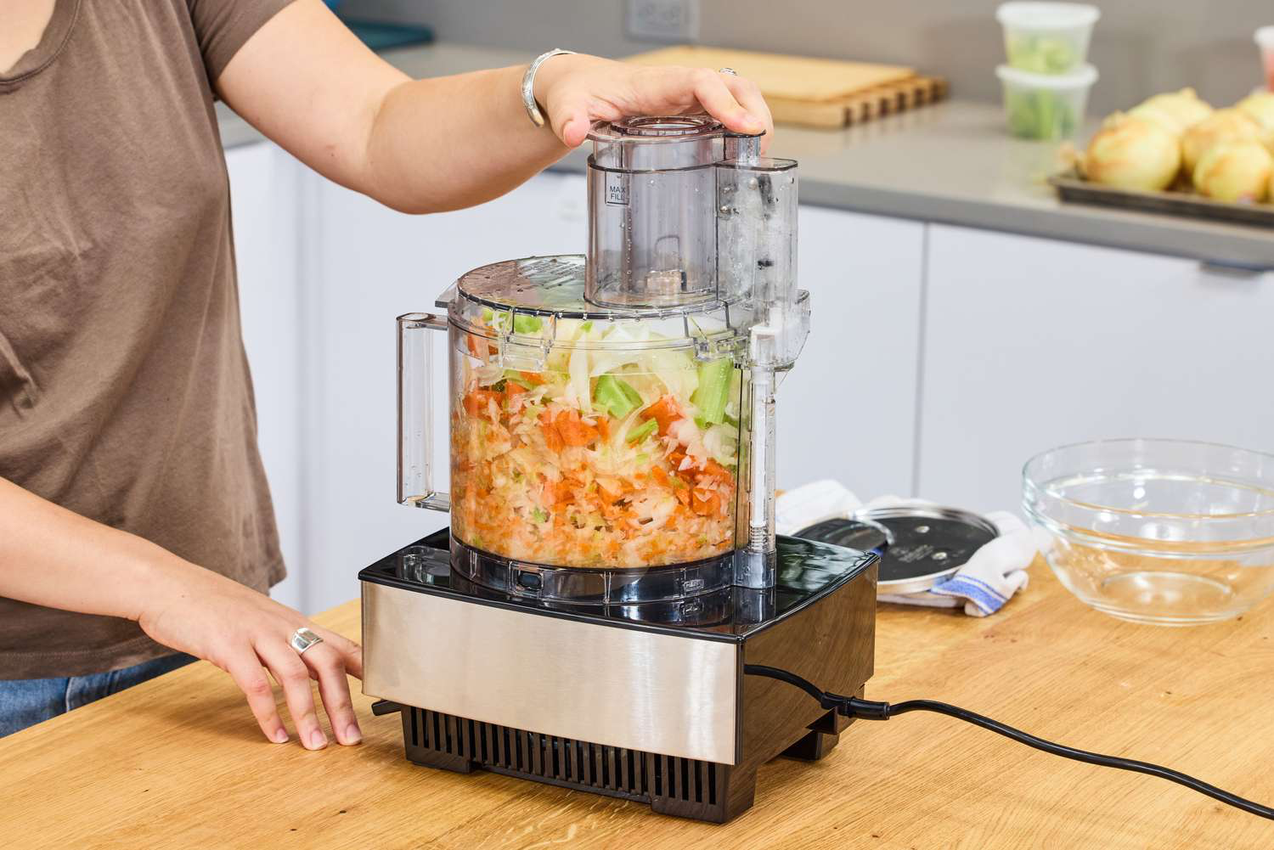
Notes:
Food processor

Slide 2
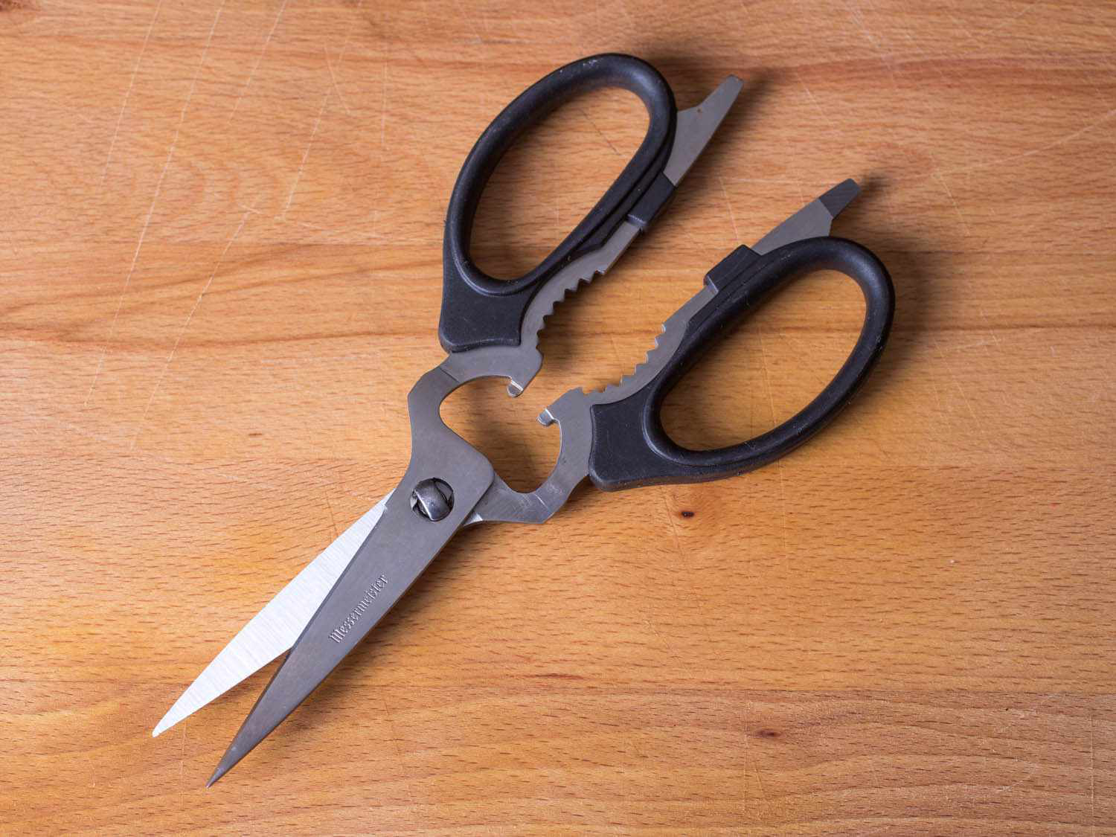
Notes:
Kitchen shears

Slide 3
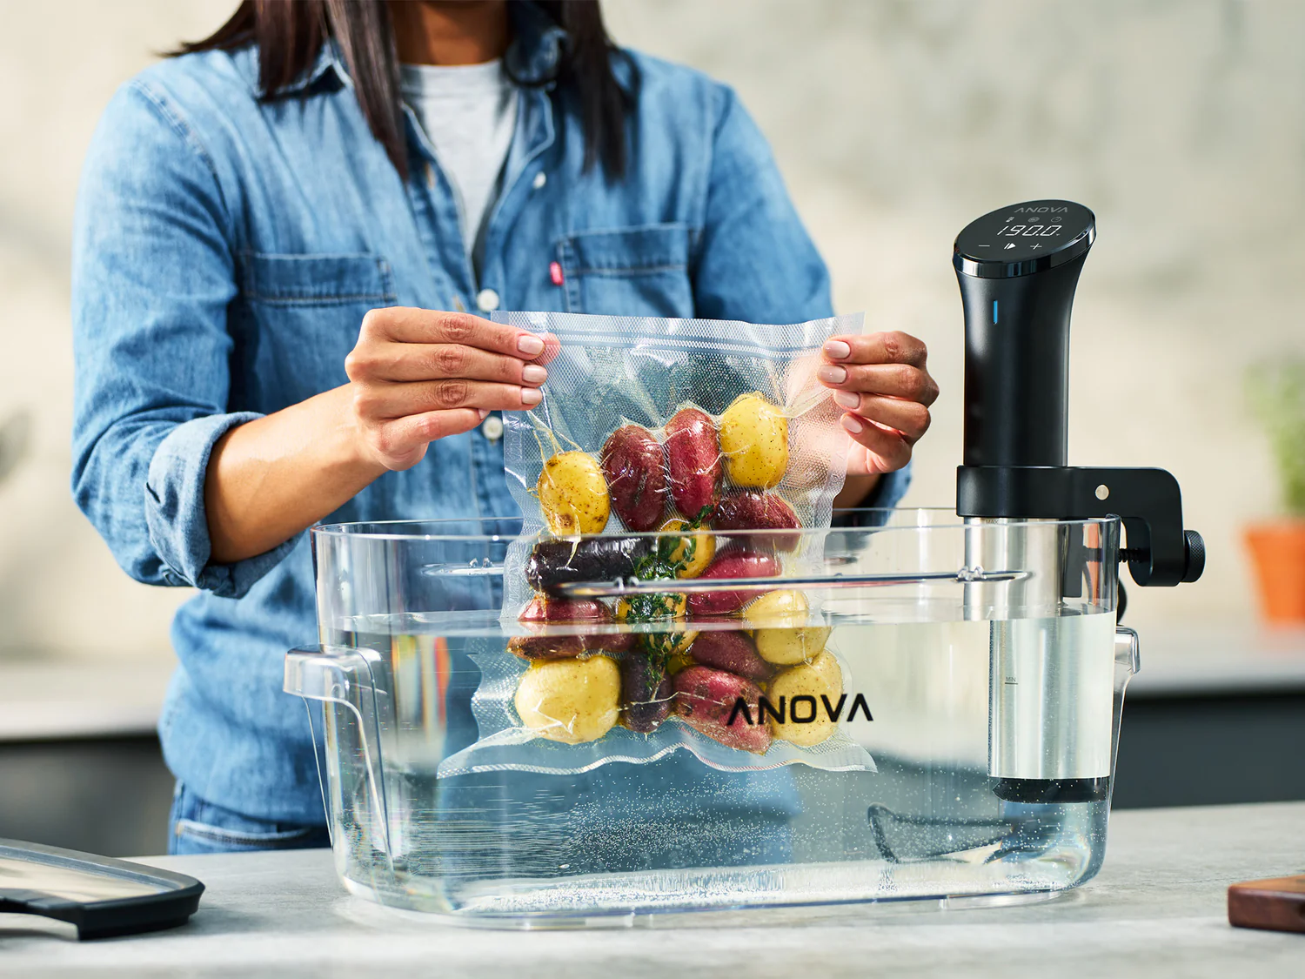
Notes:
Sous vide

Slide 4
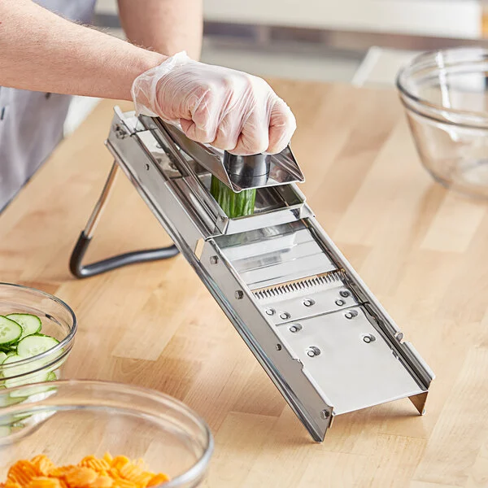
Notes:
mandoline

Slide 5
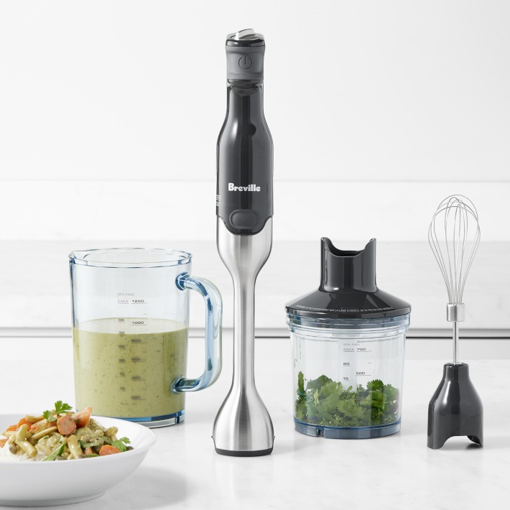
Notes:
Immersion blender

Slide 6
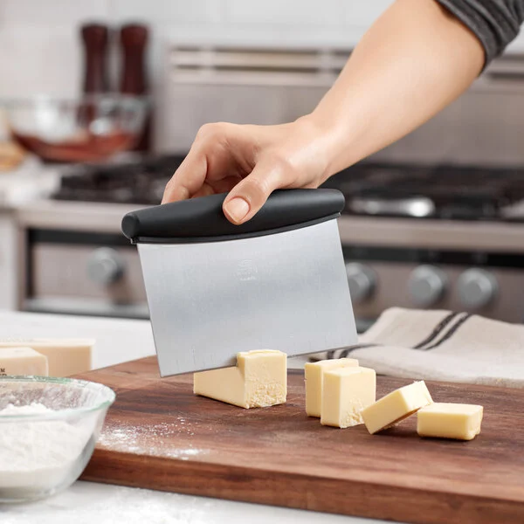
Notes:
Bench scraper

Slide 7
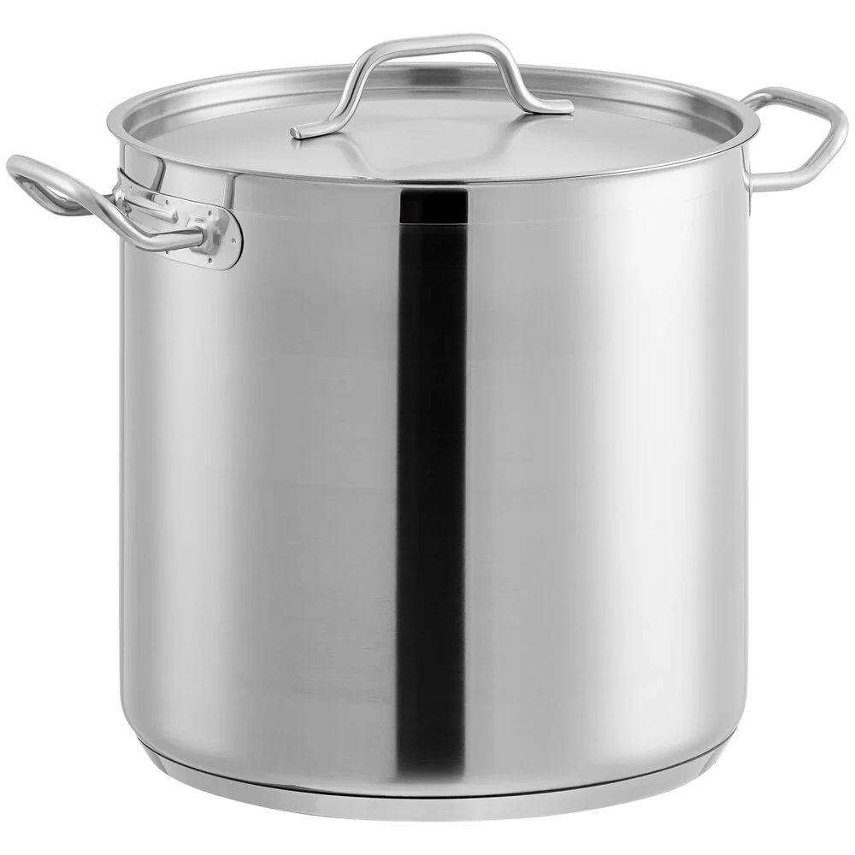
Notes:
stockpot

Slide 8
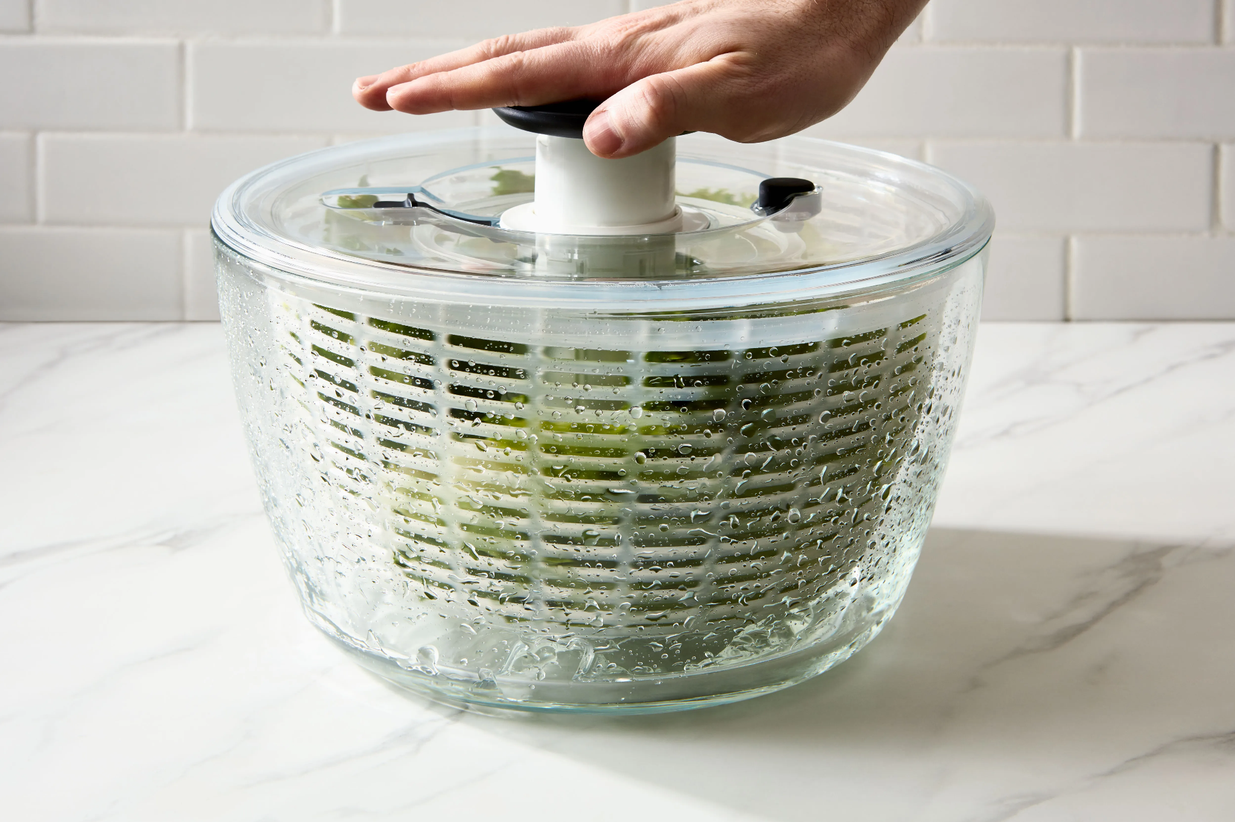
Notes:
Salad spinner

Slide 9
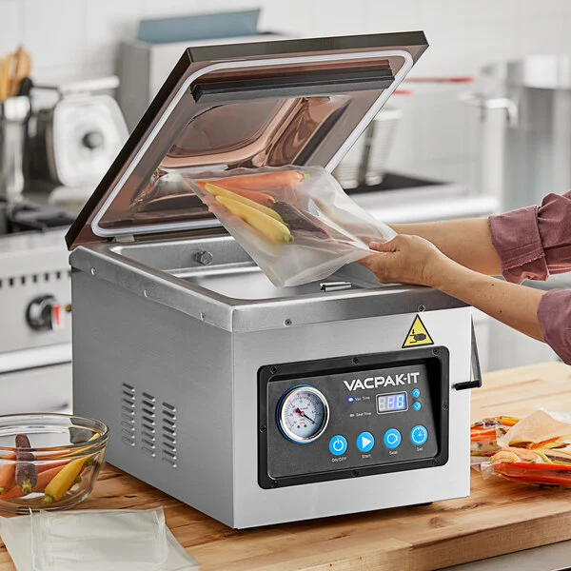
Notes:
Chamber vacuum sealer

Slide 10
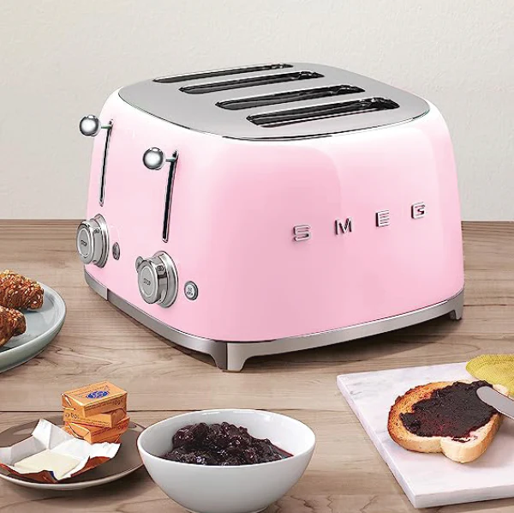
Notes:
Toaster

Slide 11
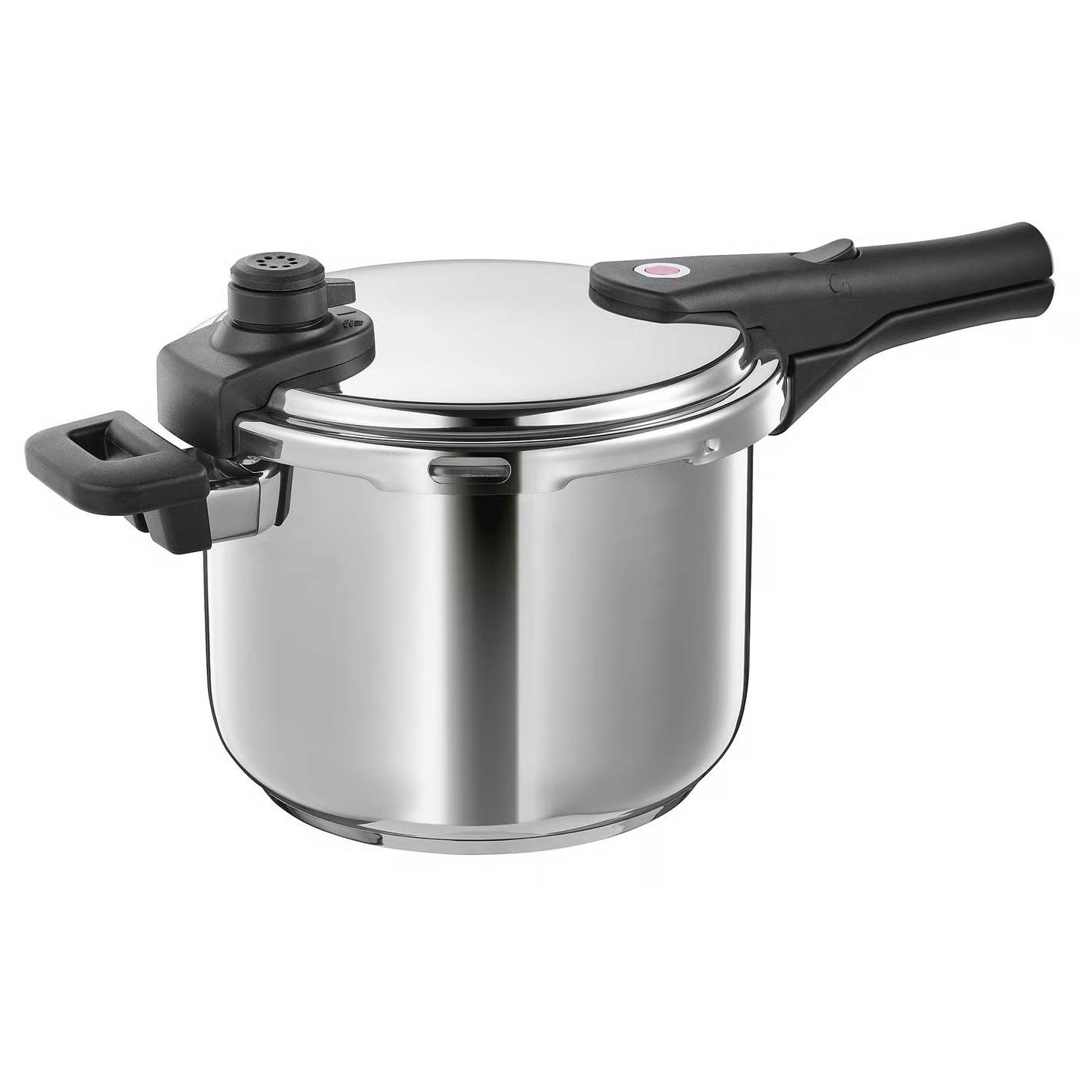
Notes:
Pressure cooker

Slide 12
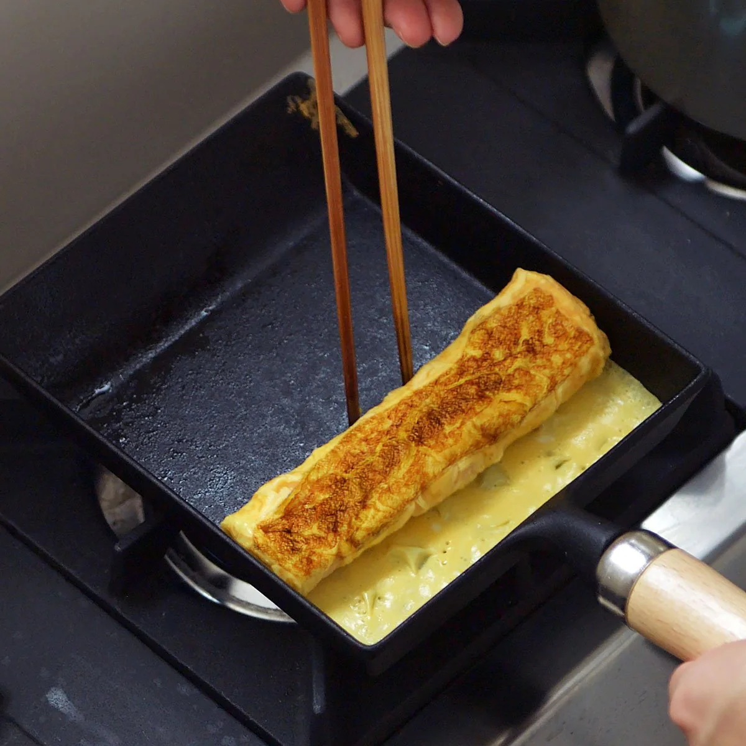
Notes:
Tamagoyaki pan

Slide 13
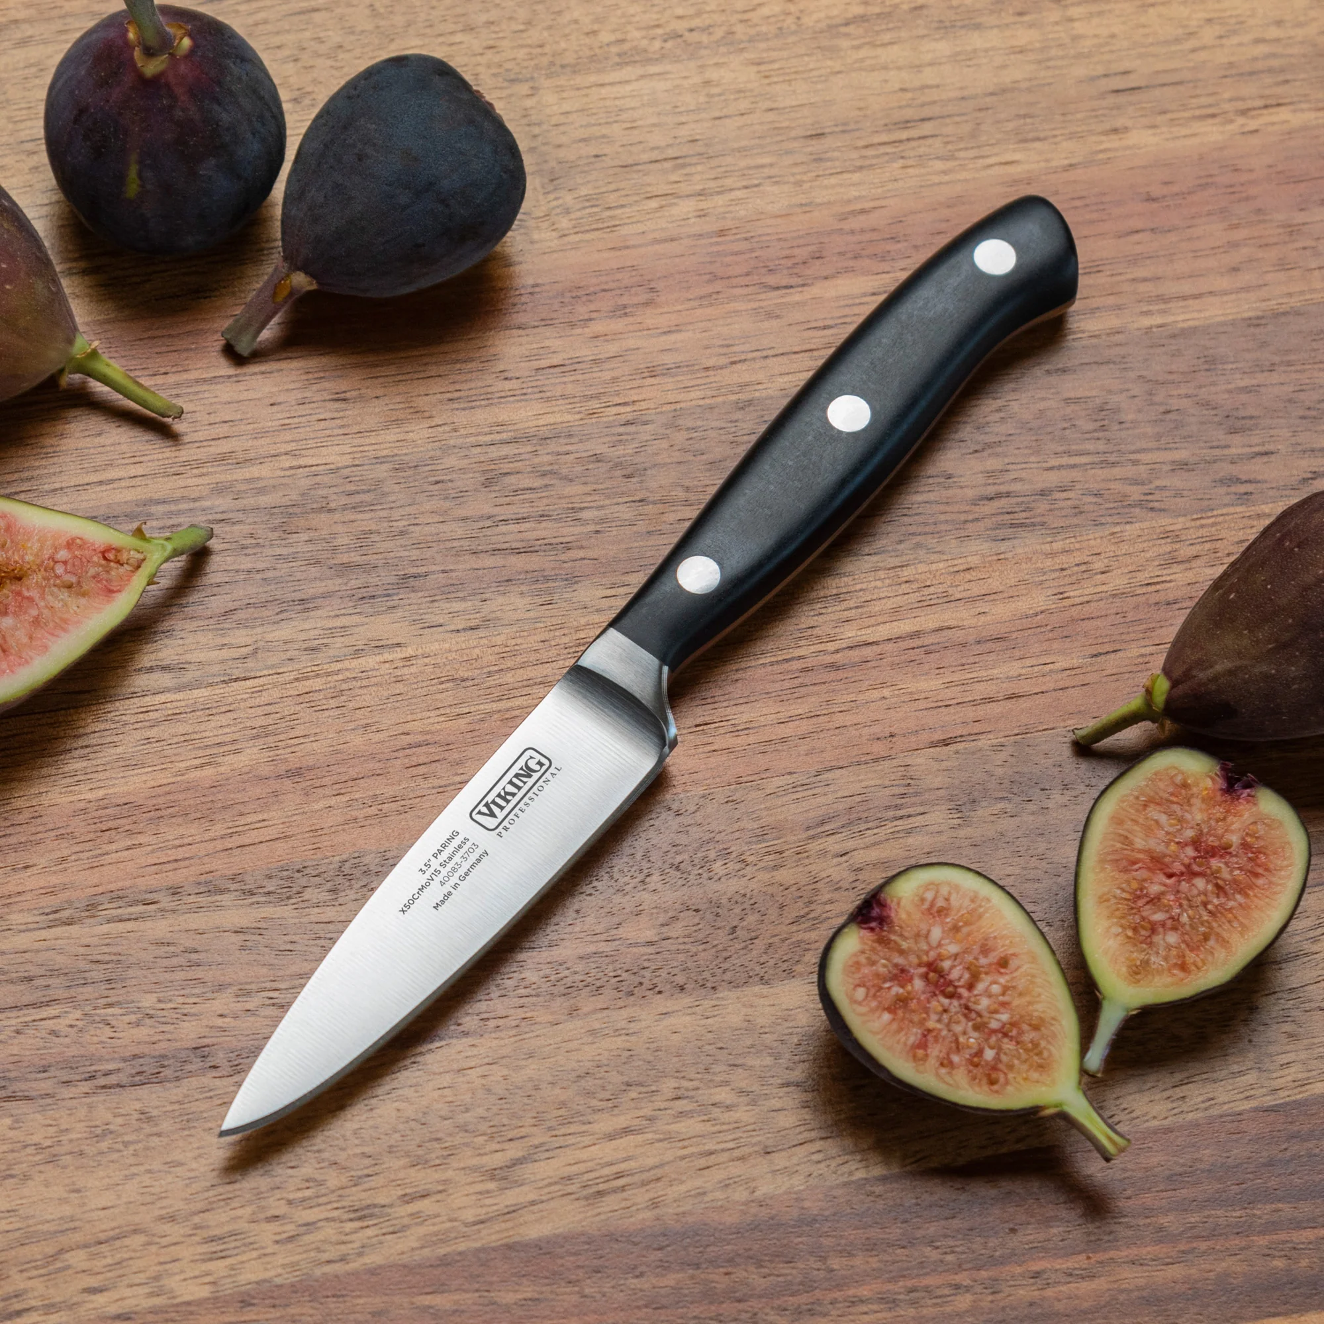
Notes:
Paring knife

Slide 14
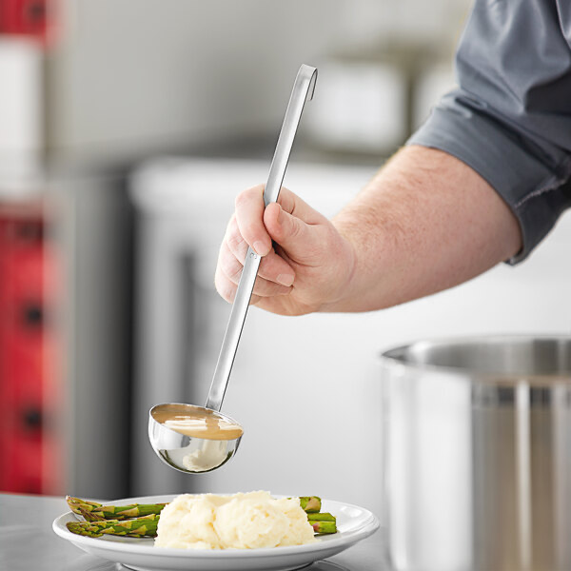
Notes:
ladle

Slide 15
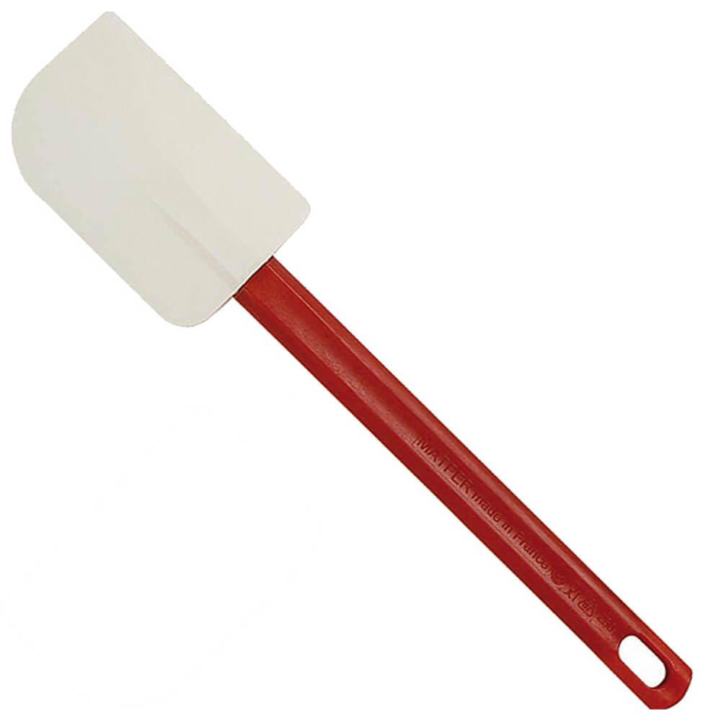
Notes:
Rubber spatula

Slide 16
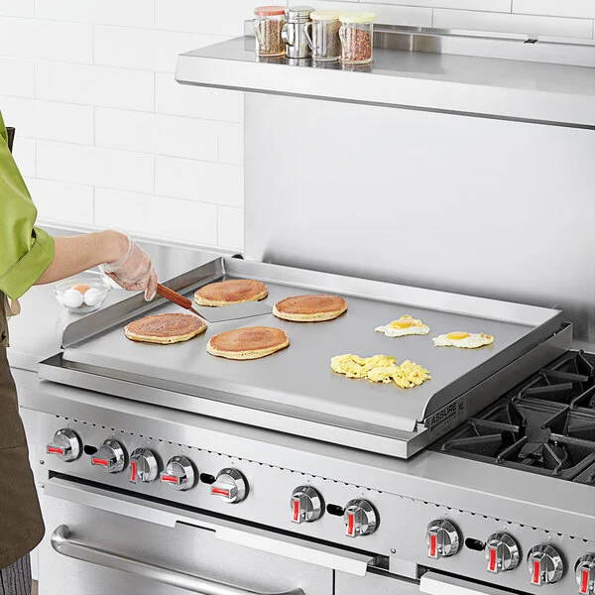
Notes:
griddle

Slide 17
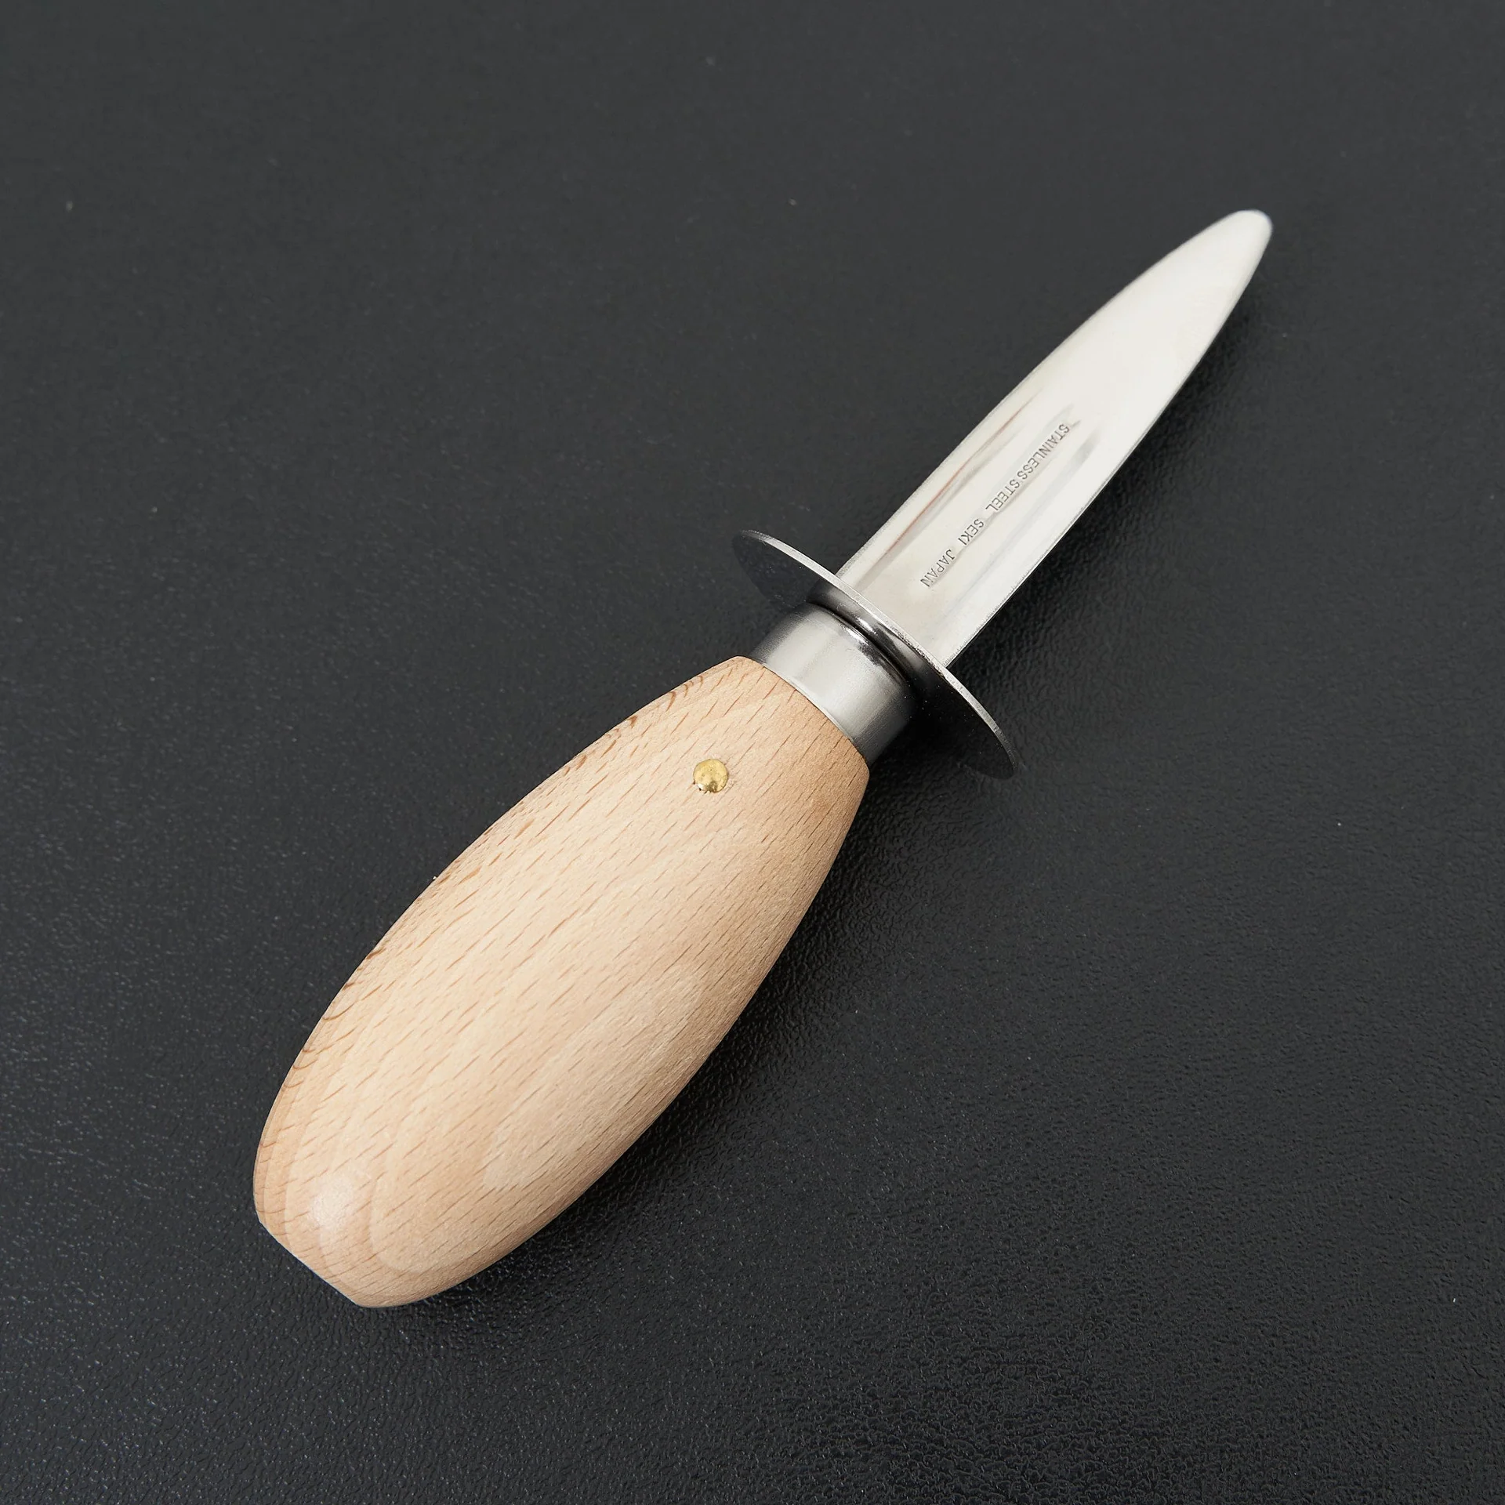
Notes:
Oyster knife

Slide 18
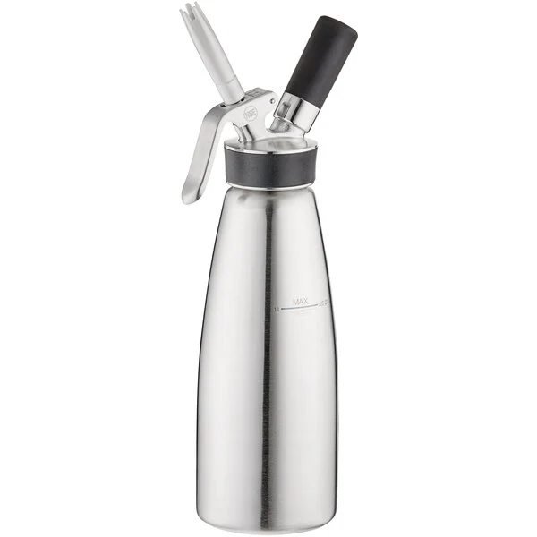
Notes:
Isi whipper

Slide 19
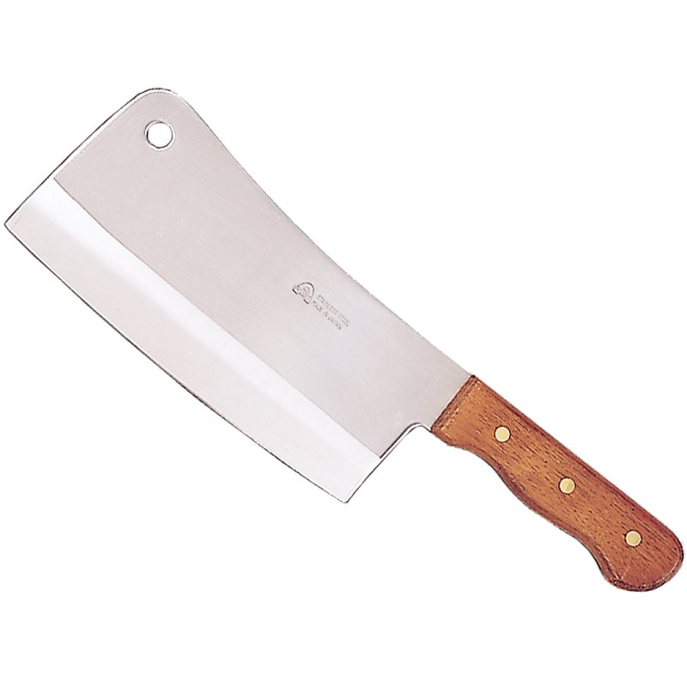
Notes:
cleaver

Slide 20
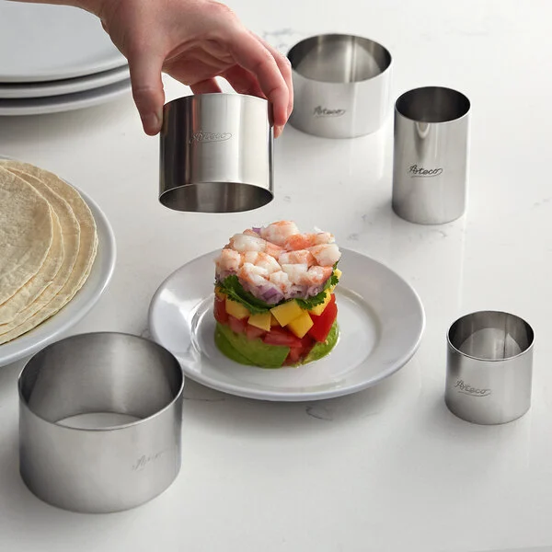
Notes:
Ring mold

Slide 21
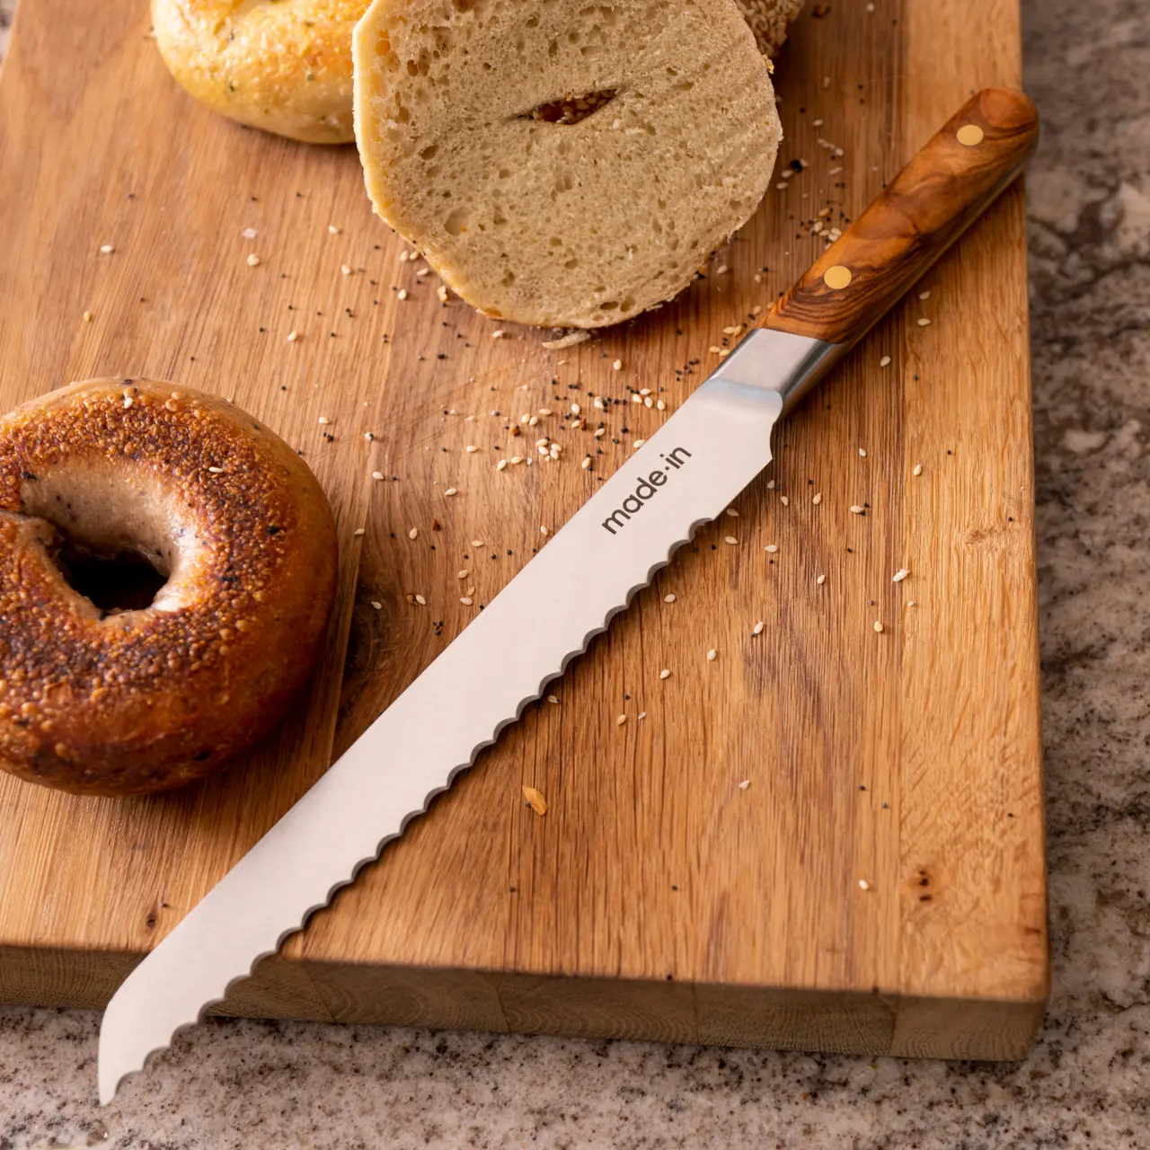
Notes:
Bread knife

Slide 22
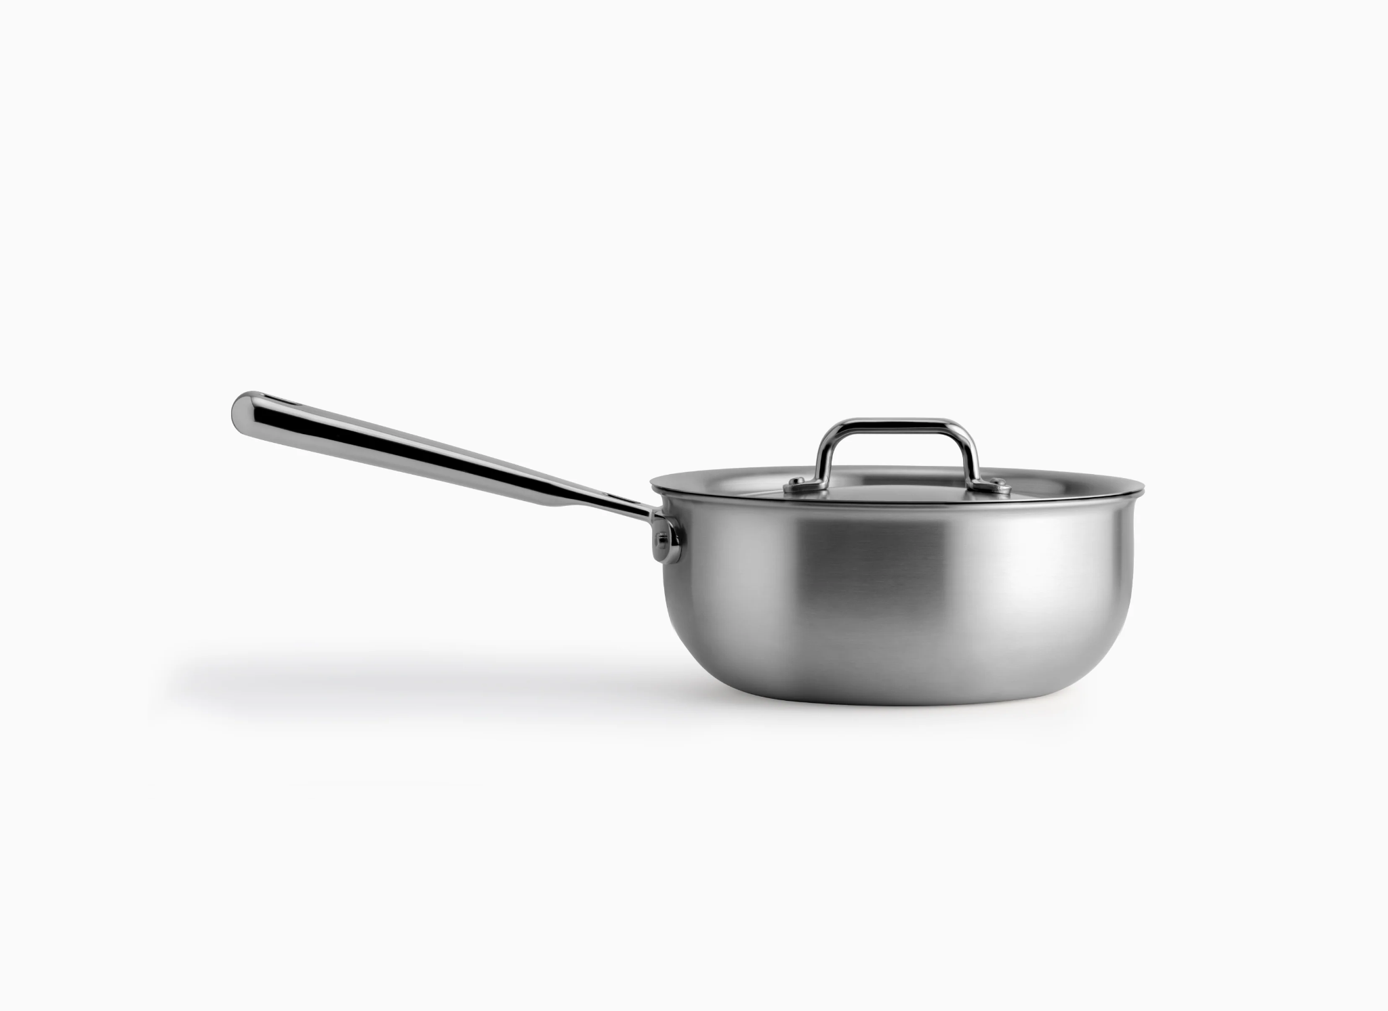
Notes:
saucier

Slide 23
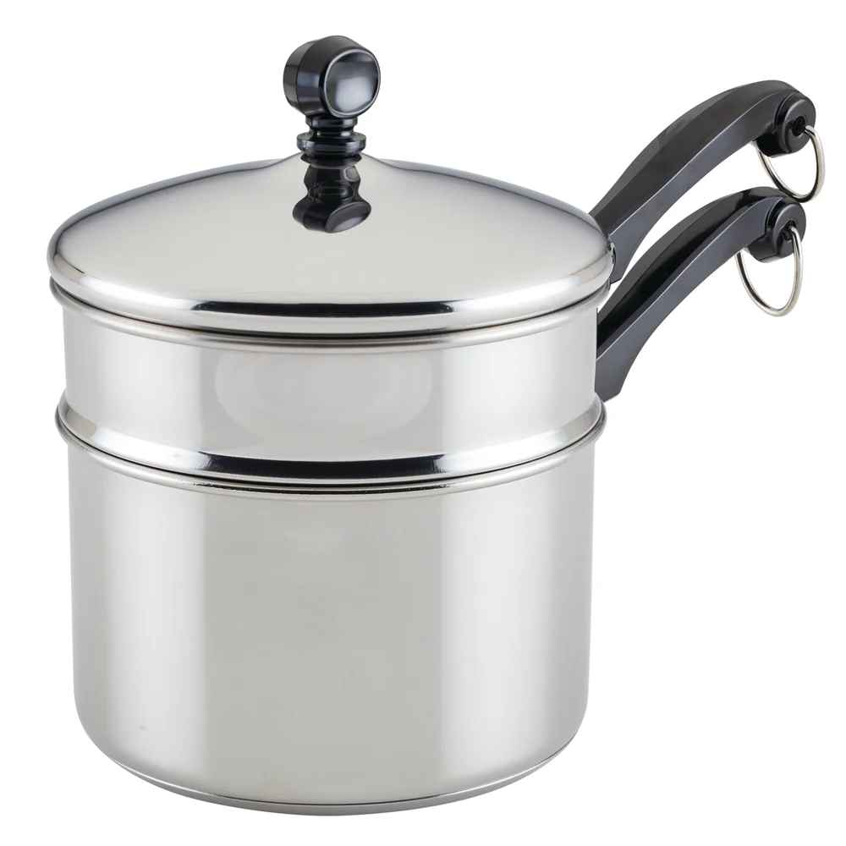
Notes:
Double boiler

Slide 24
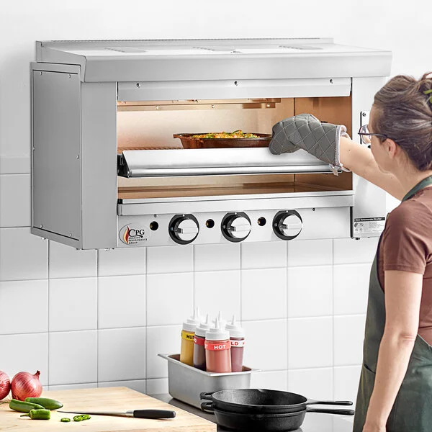
Notes:
salamander

Slide 25
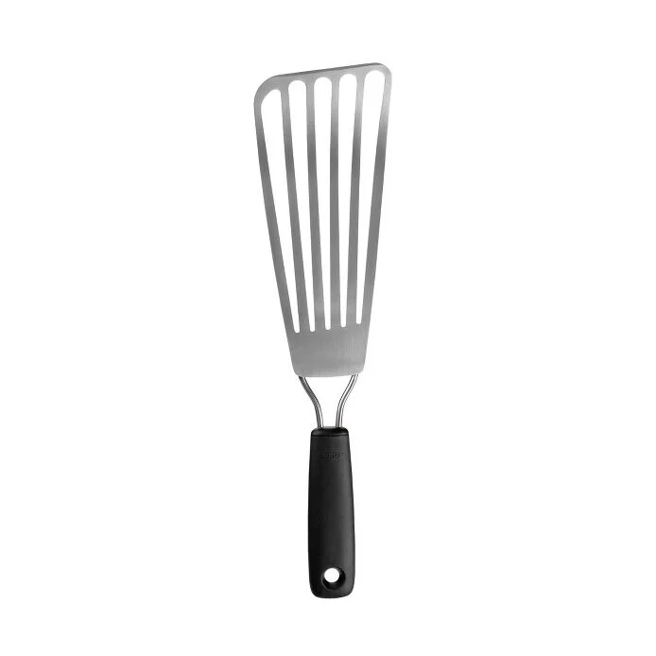
Notes:
Fish turner

Slide 26
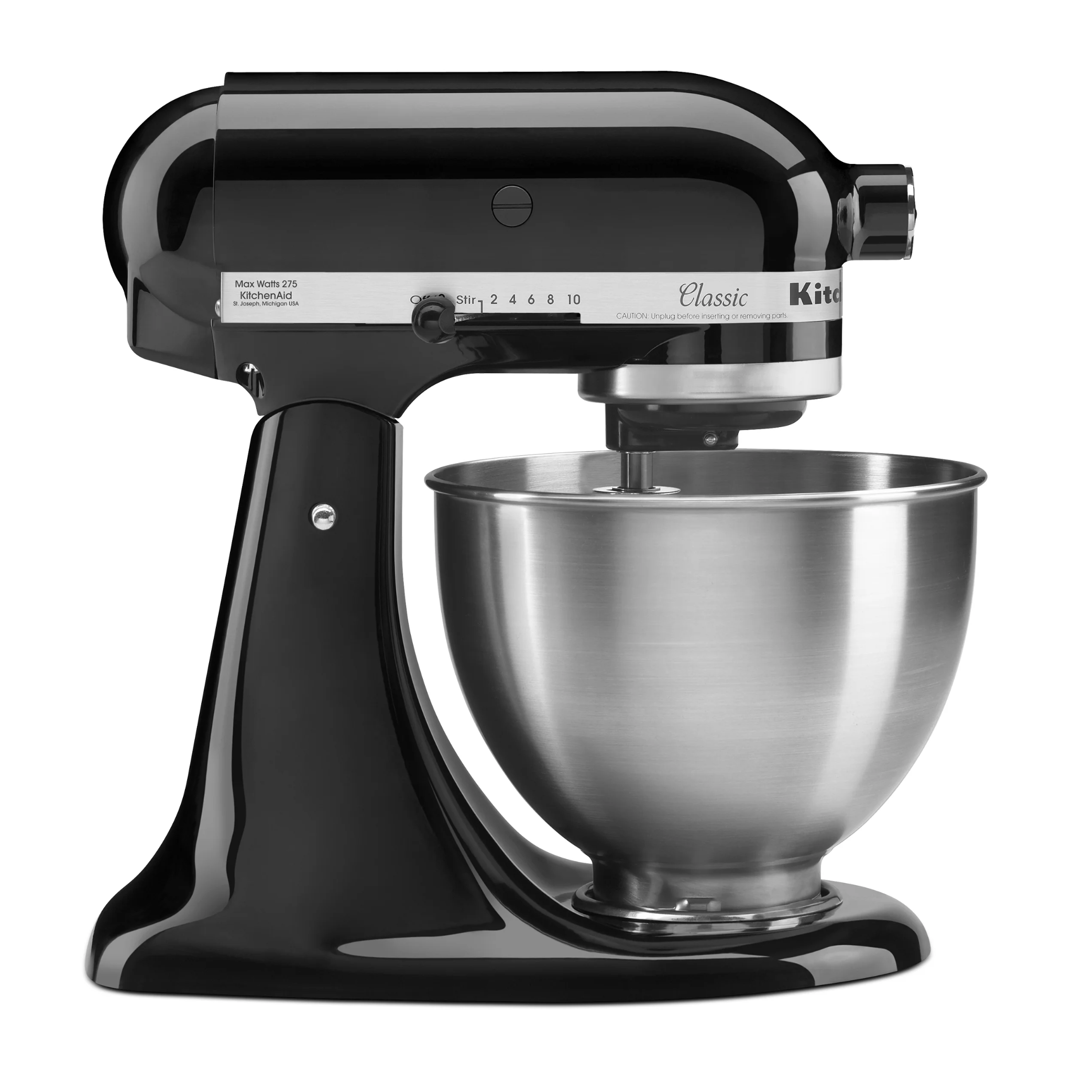
Notes:
Stand mixer

Slide 27
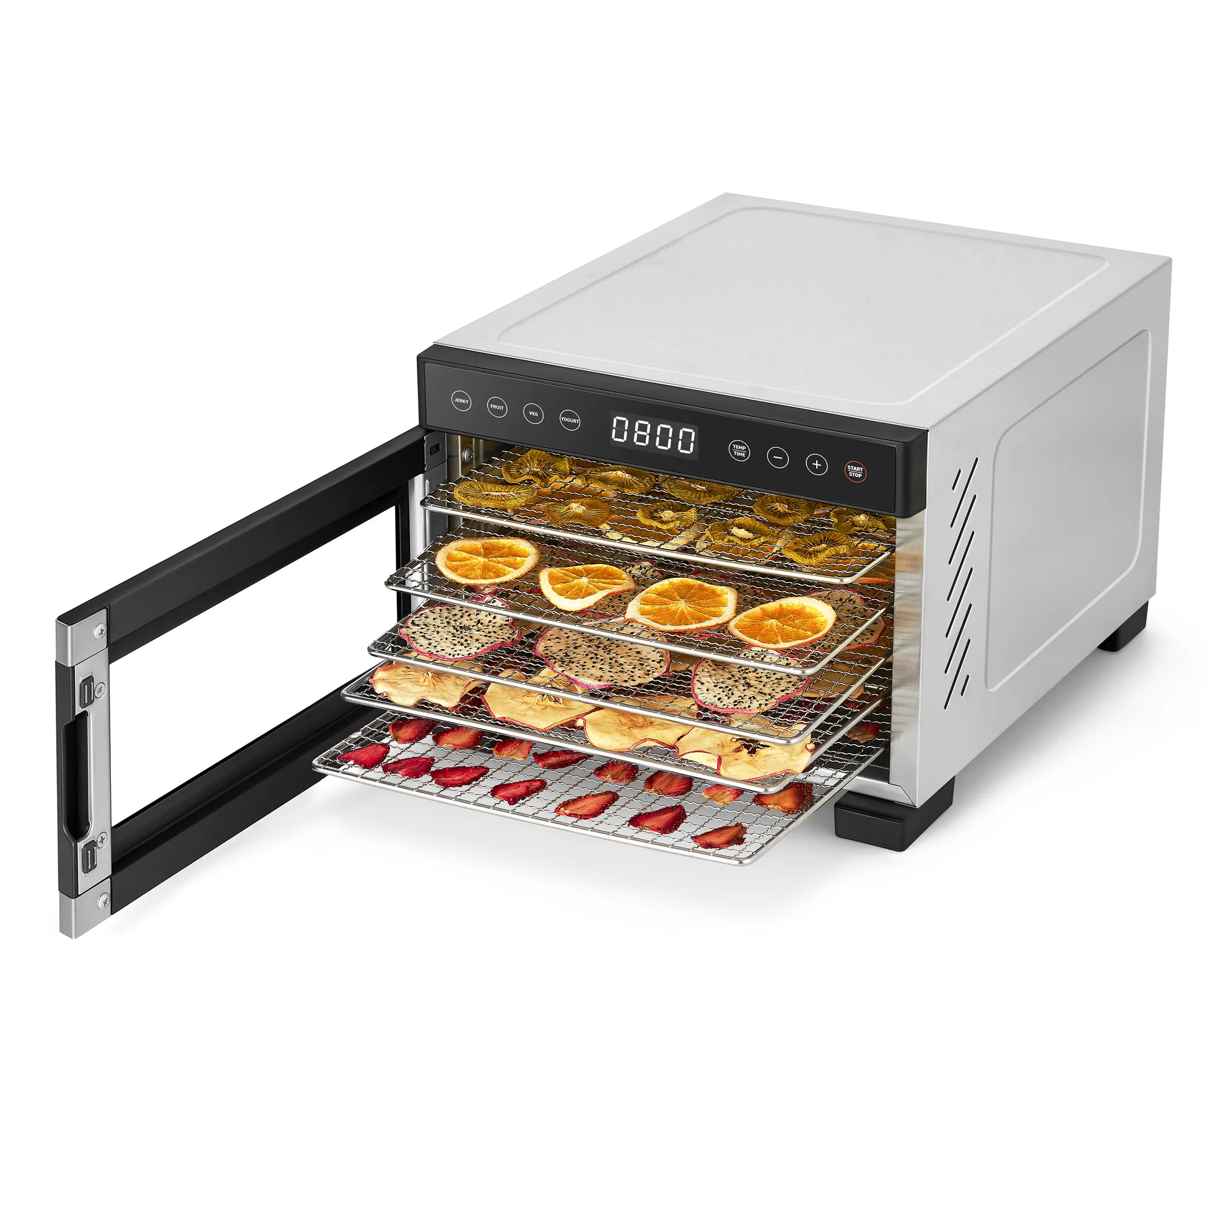
Notes:
dehydrator

Slide 28
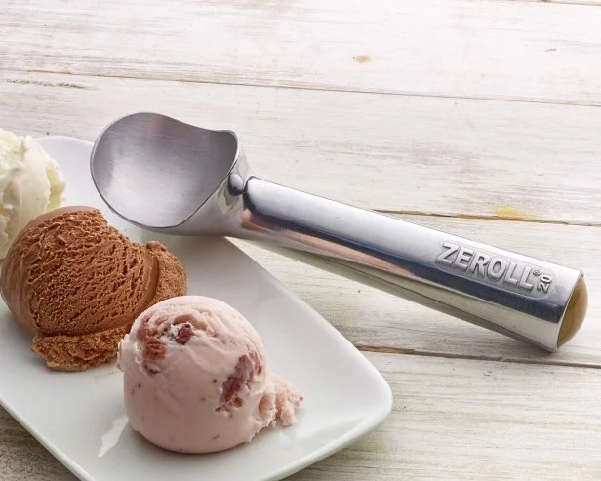
Notes:
Ice cream scoop

Slide 29
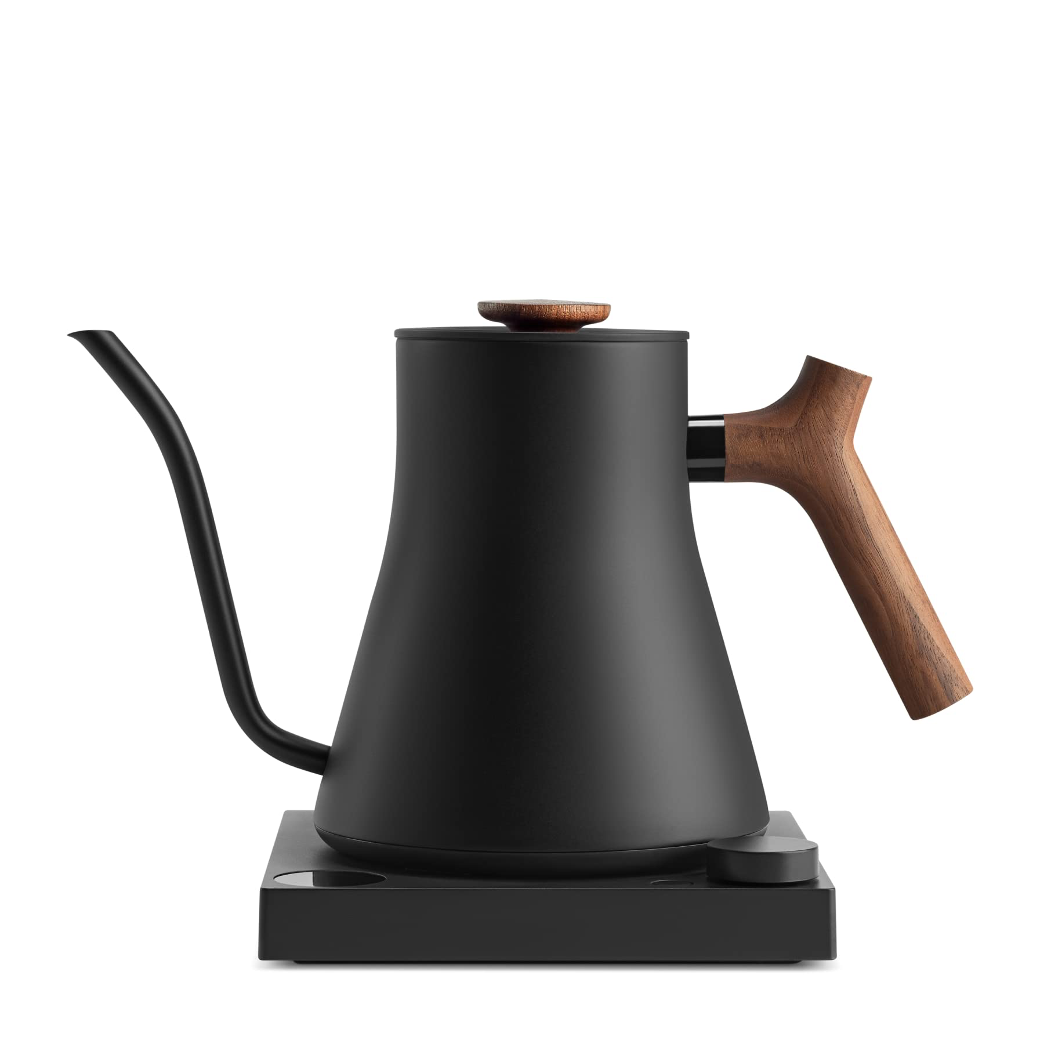
Notes:
Gooseneck kettle

Slide 30
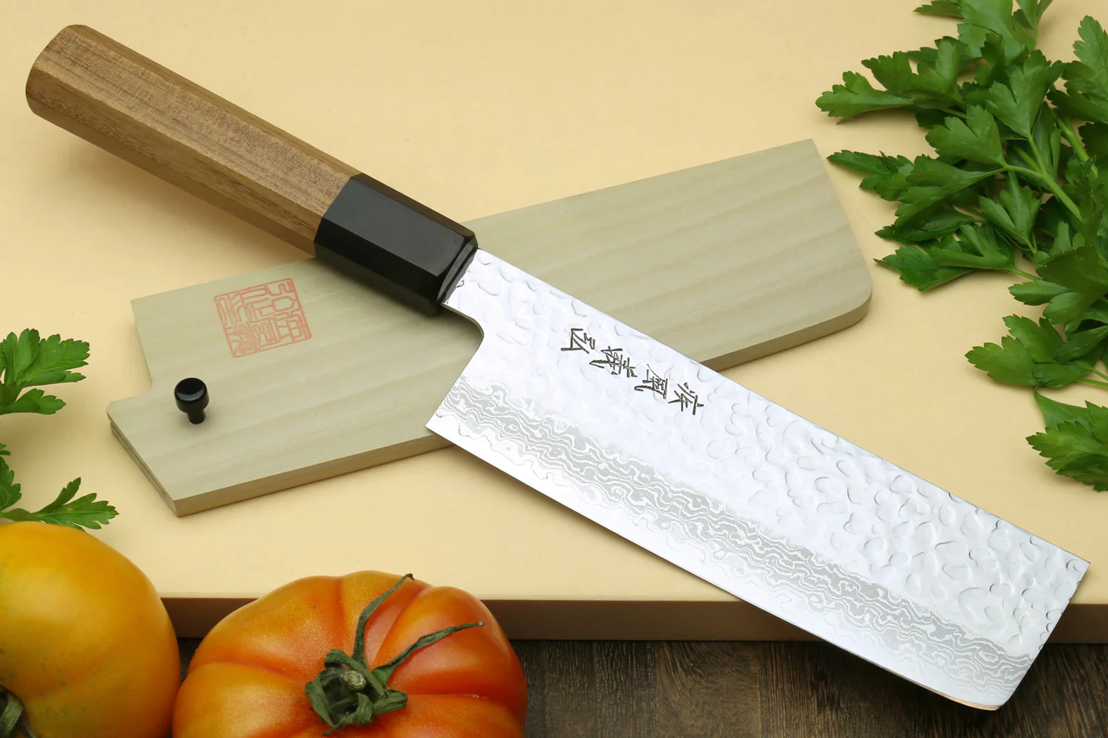
Notes:
nakiri

Slide 31
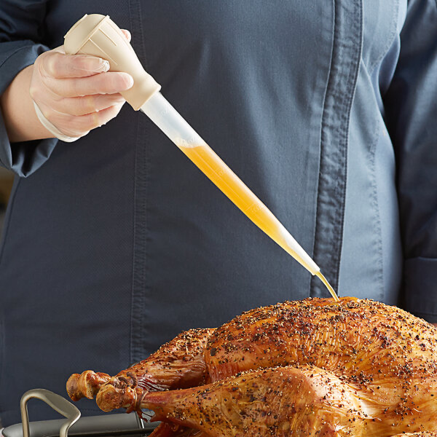
Notes:
Turkey baster

Slide 32
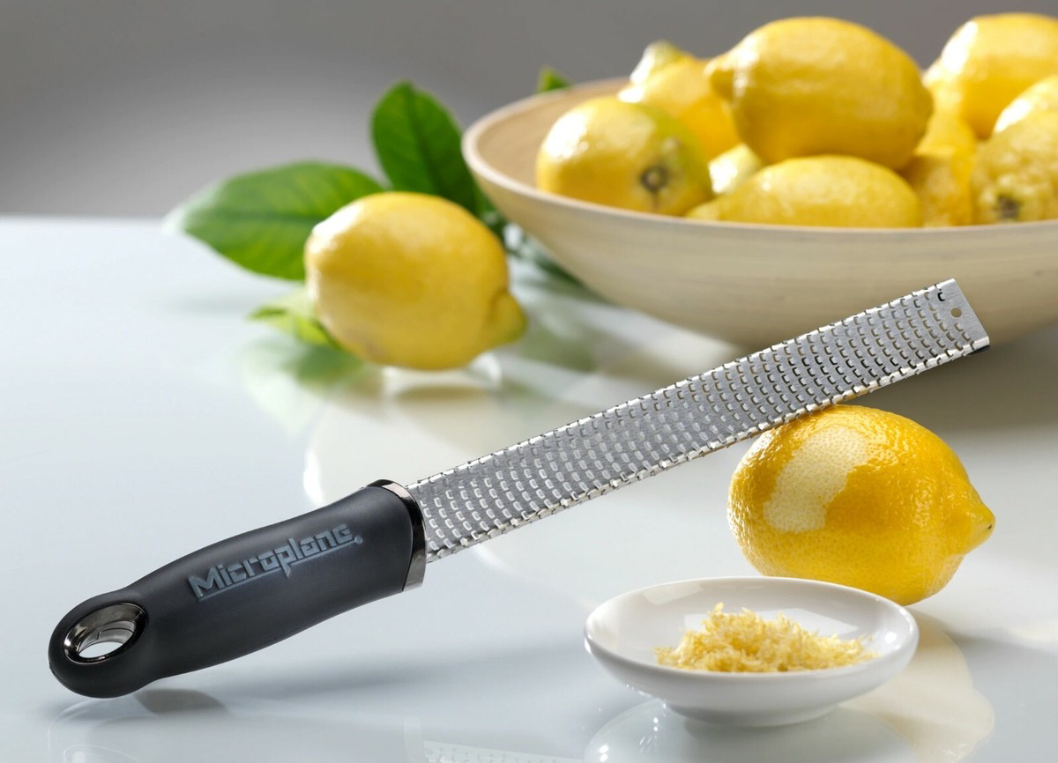
Notes:
microplane

Slide 33
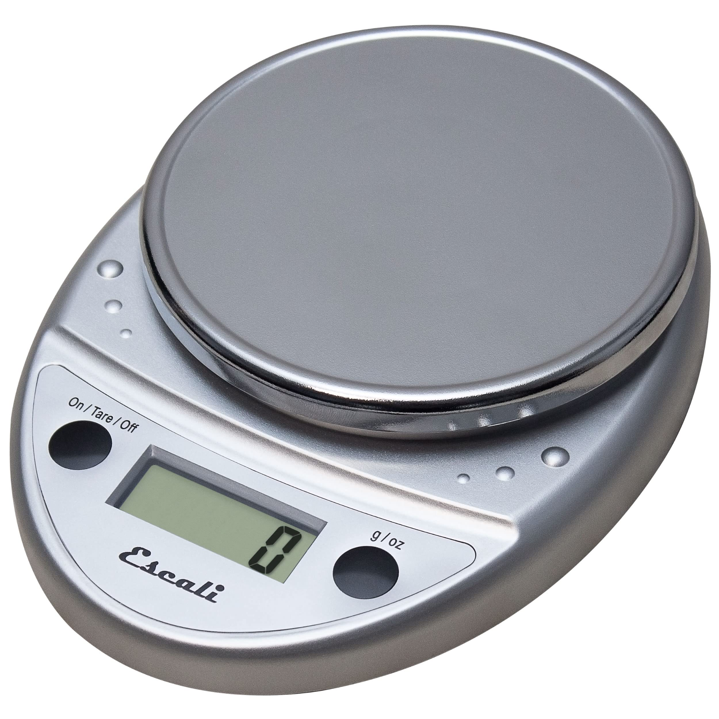
Notes:
Kitchen scale

Slide 34
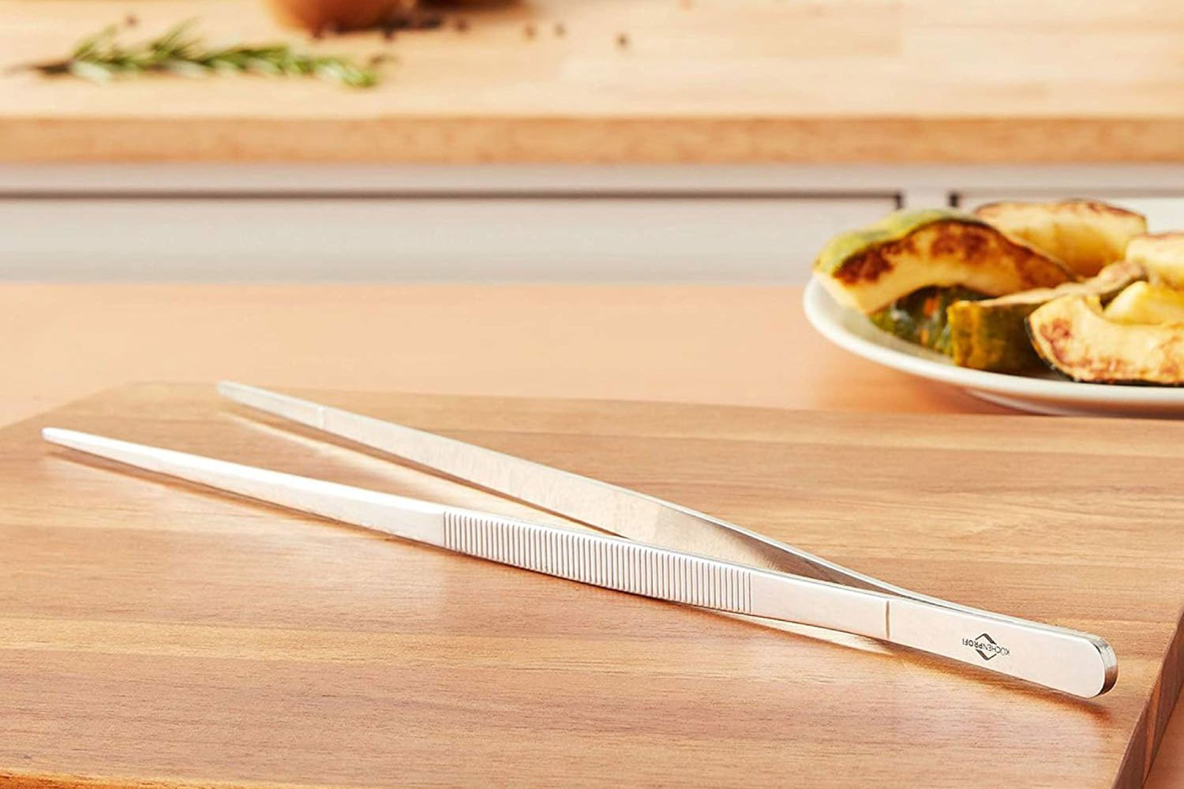
Notes:
Kitchen tweezers

Slide 35
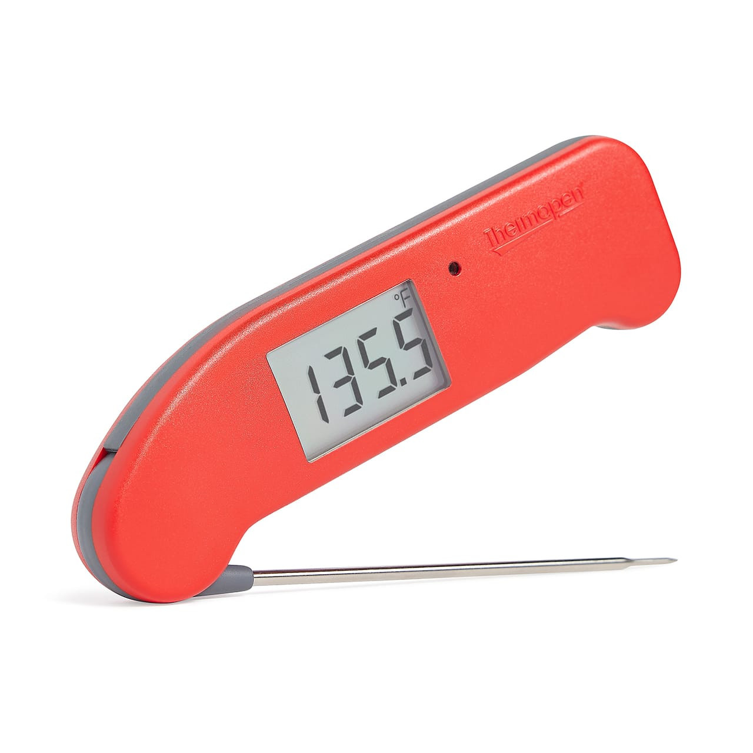
Notes:
thermapen

Slide 36
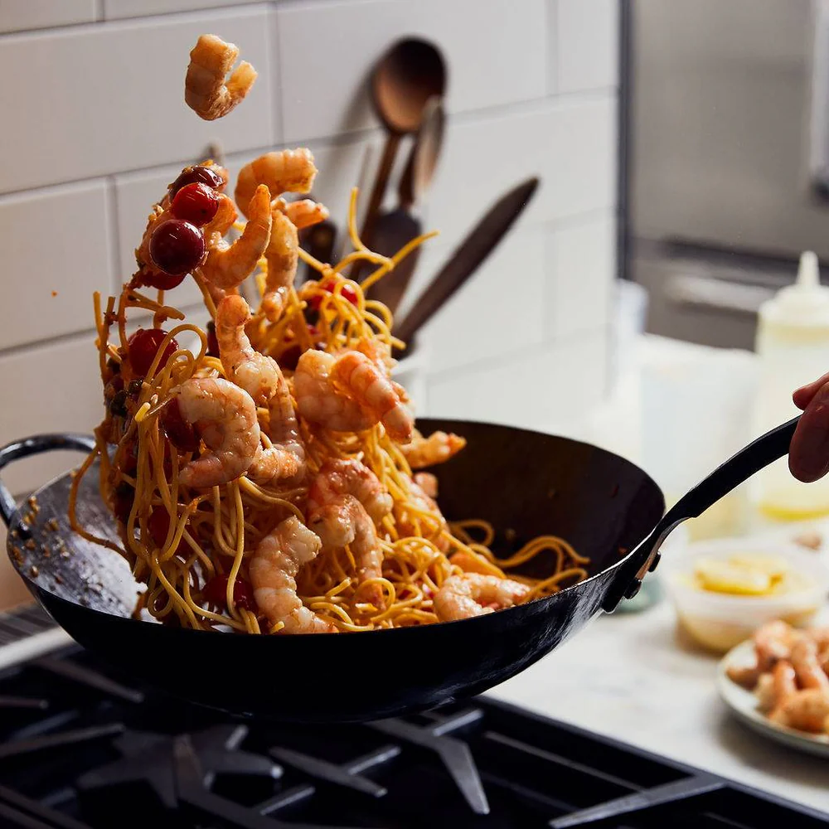
Notes:
wok

Slide 37
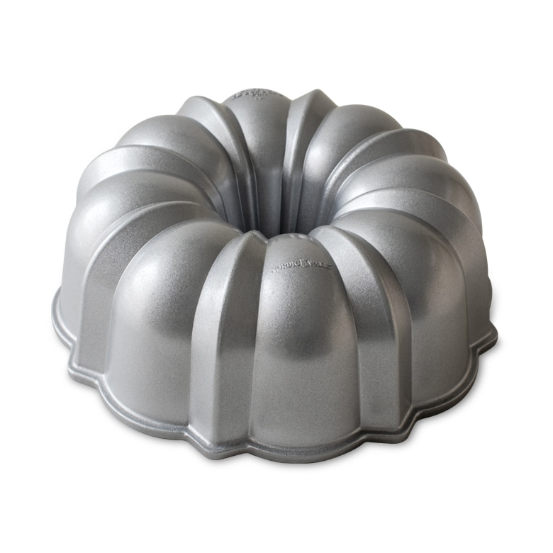
Notes:
Bundt pan

Slide 38
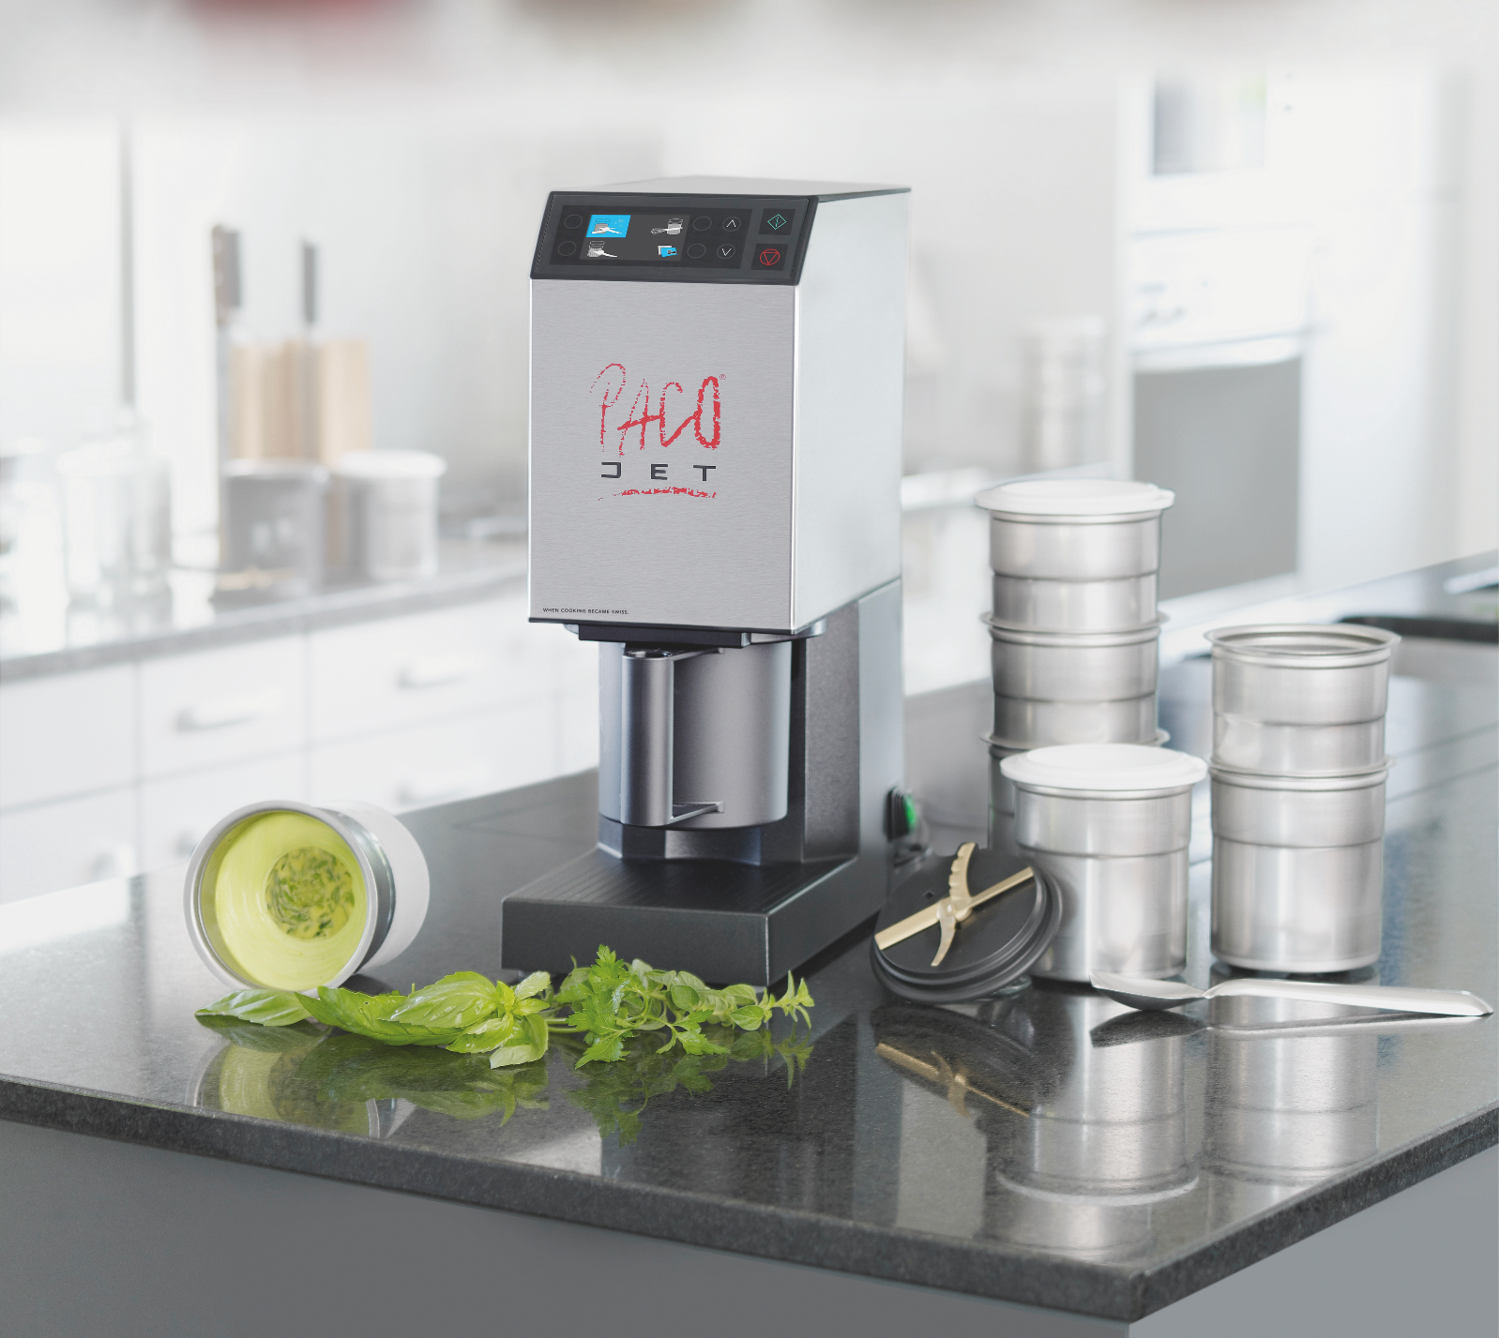
Notes:
pacojet

Slide 39
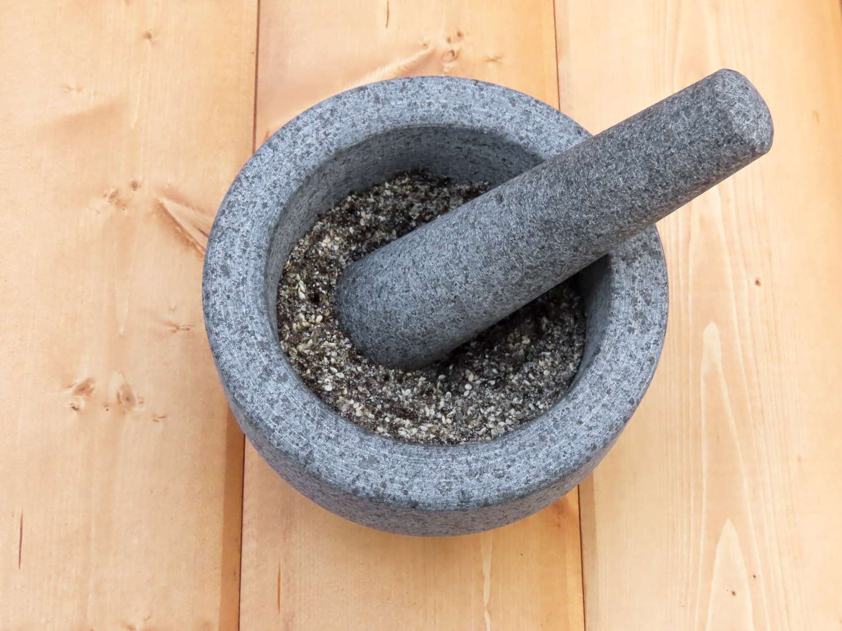
Notes:
Mortar and pestle

Slide 40
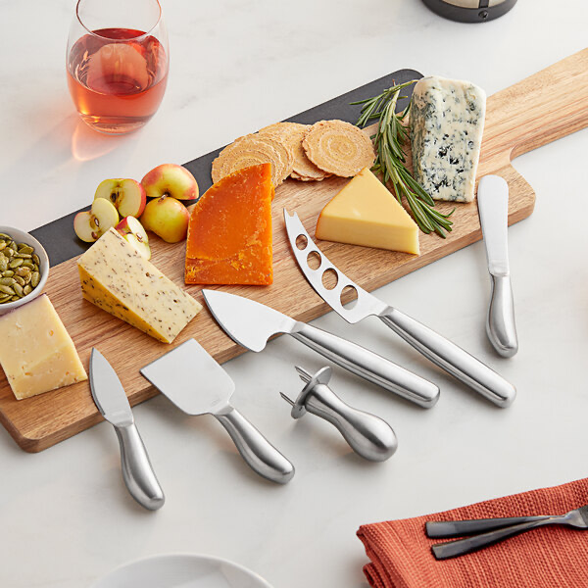
Notes:
Cheese knives

Slide 41
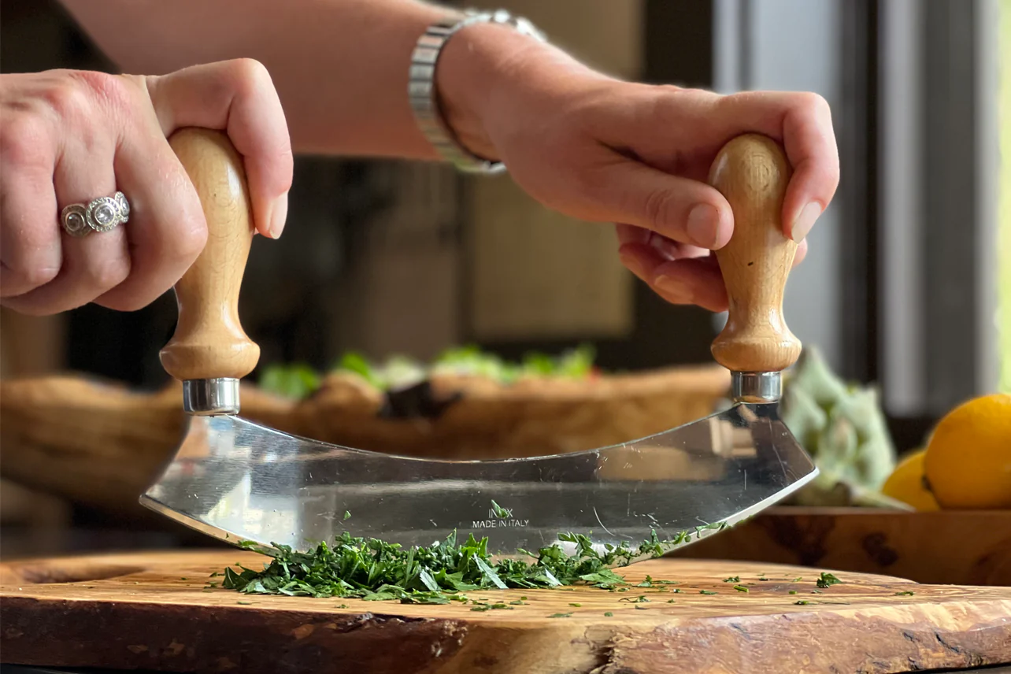
Notes:
mezzaluna

Slide 42
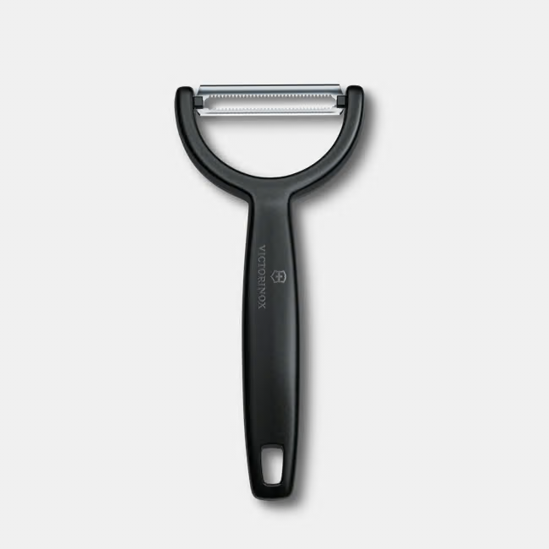
Notes:
peeler

Slide 43
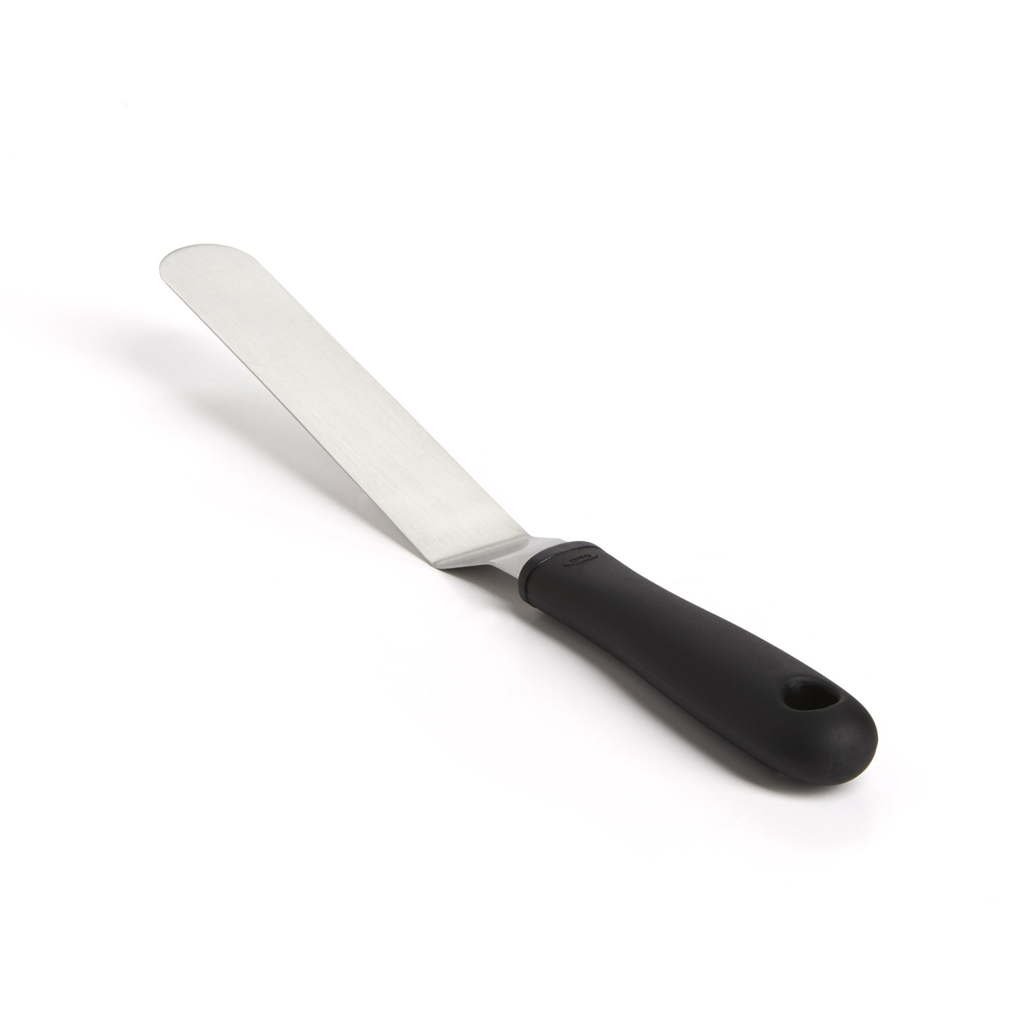
Notes:
Offset spatula

Slide 44
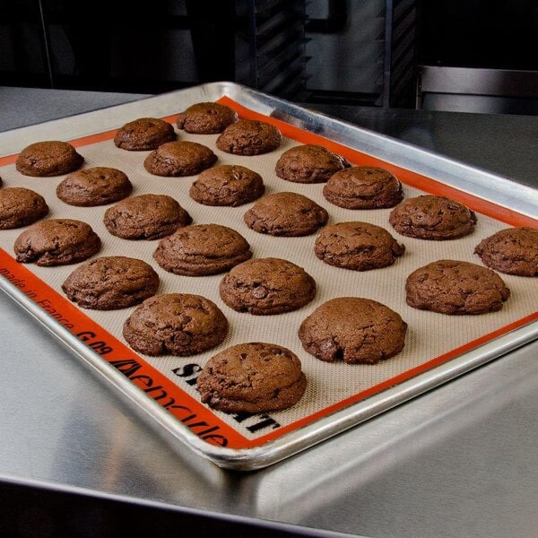
Notes:
Silpat

Slide 45
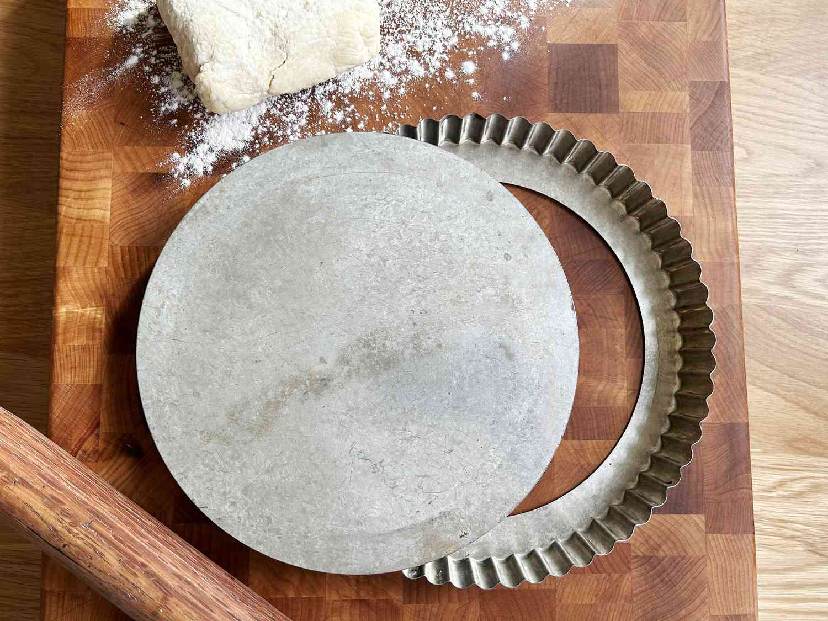
Notes:
Tart pan

Slide 46
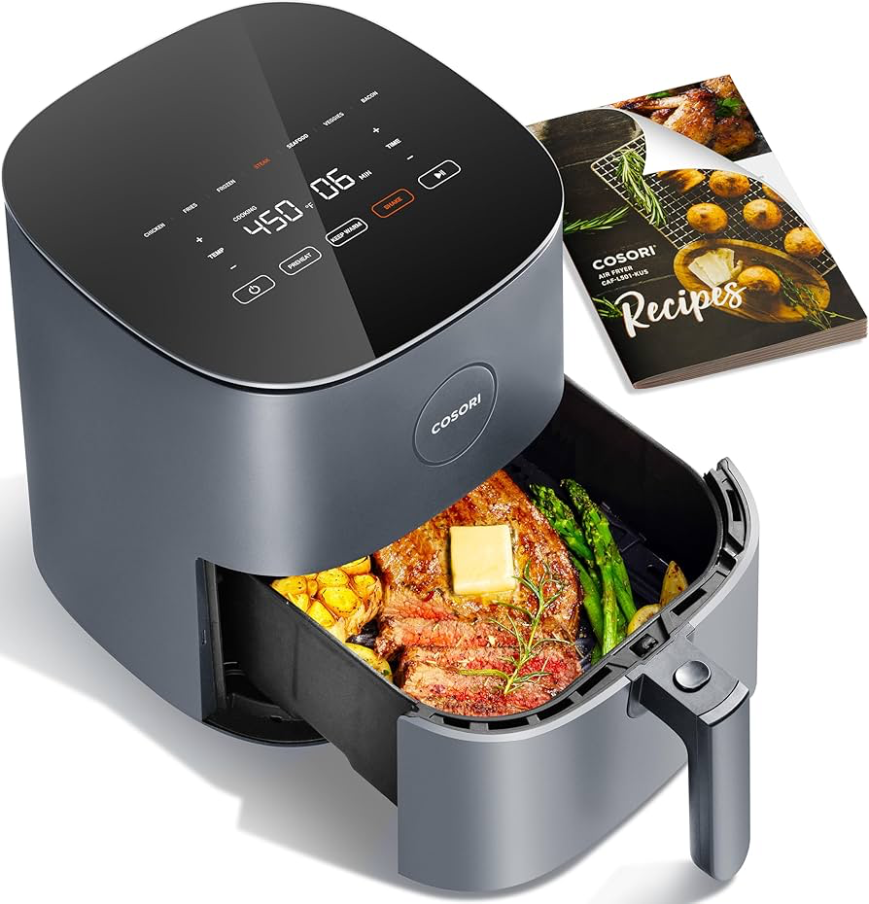
Notes:
Air fryer

Slide 47
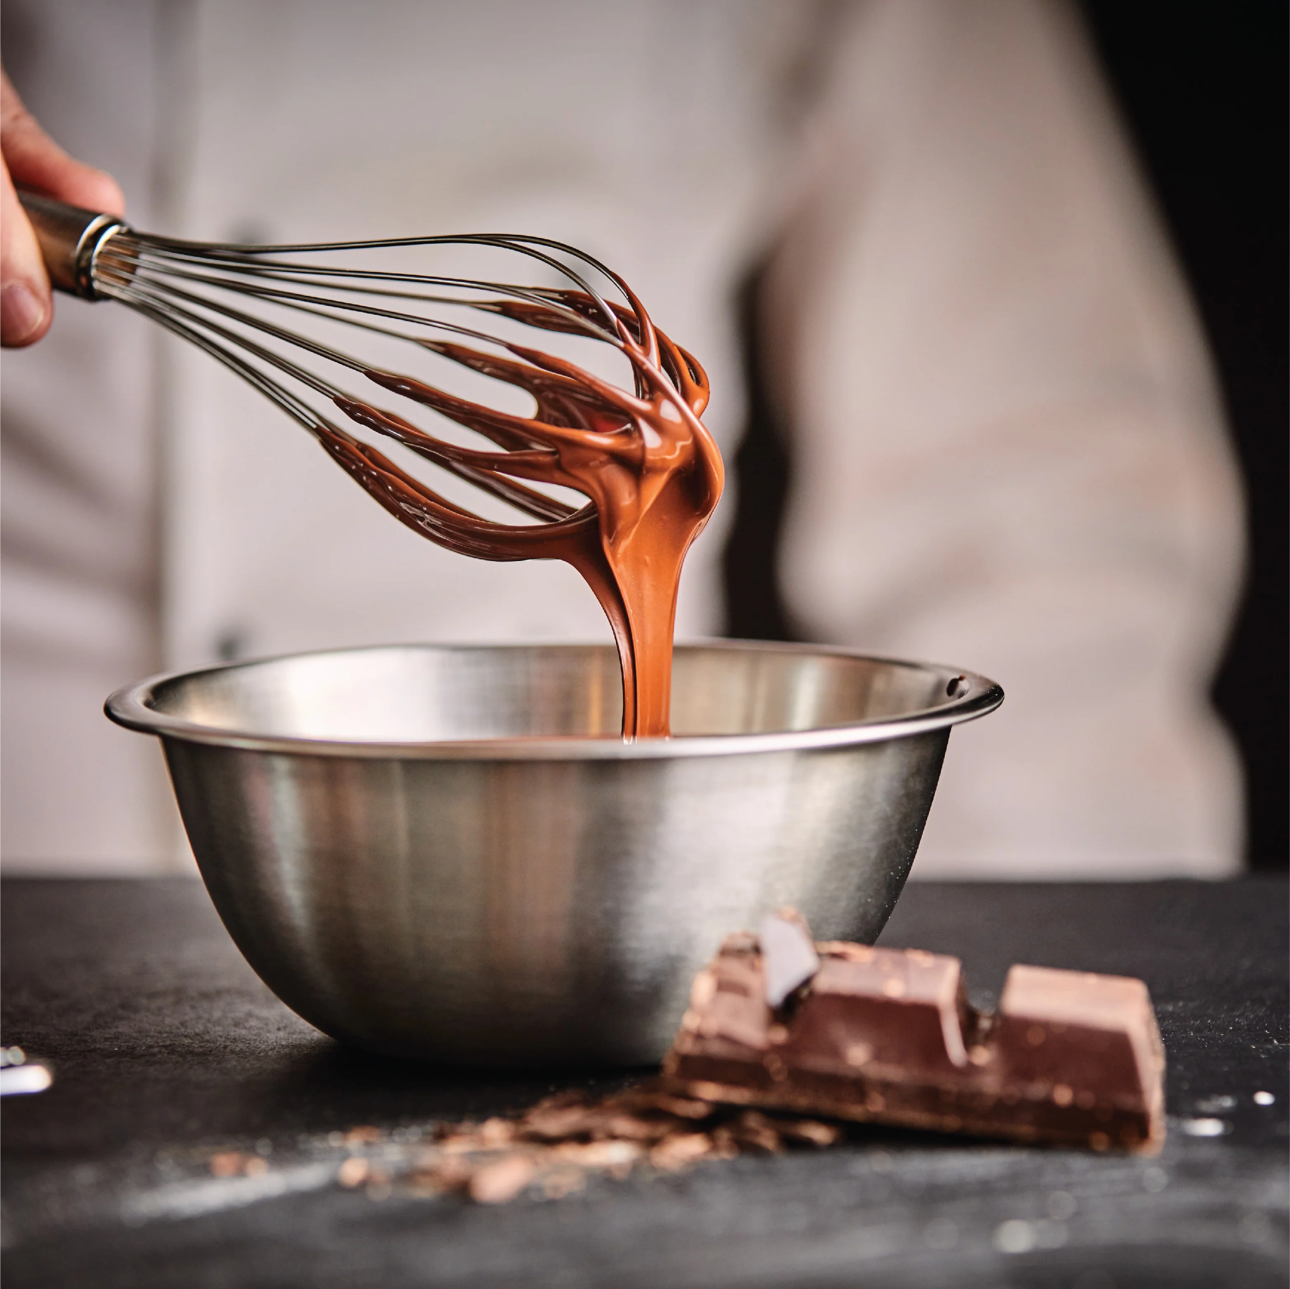
Notes:
whisk

Slide 48
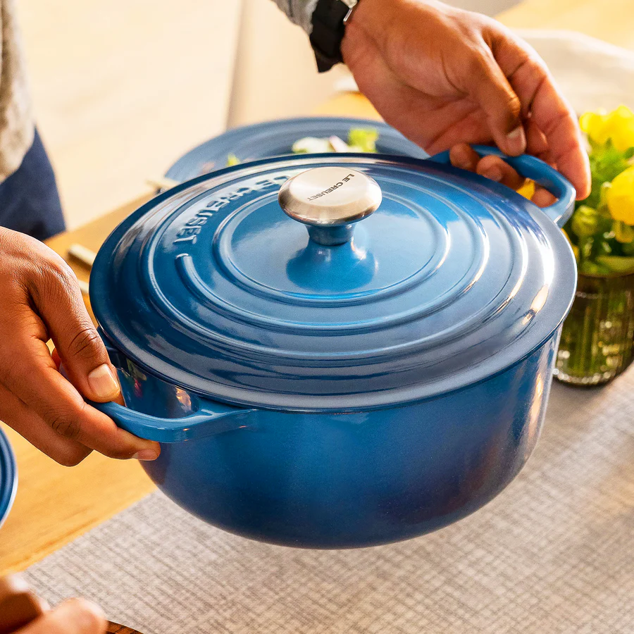
Notes:
Dutch oven

Slide 49
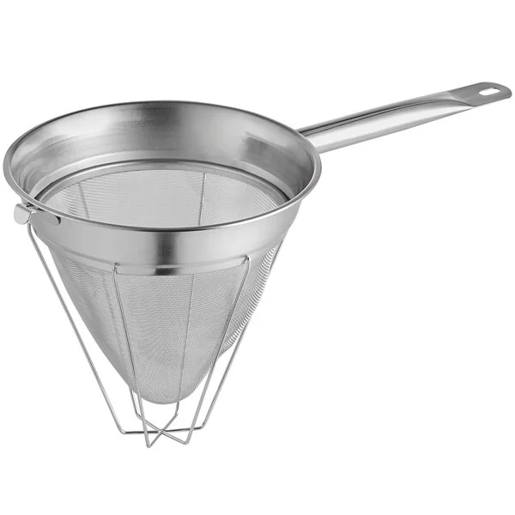
Notes:
Chinois

Slide 50
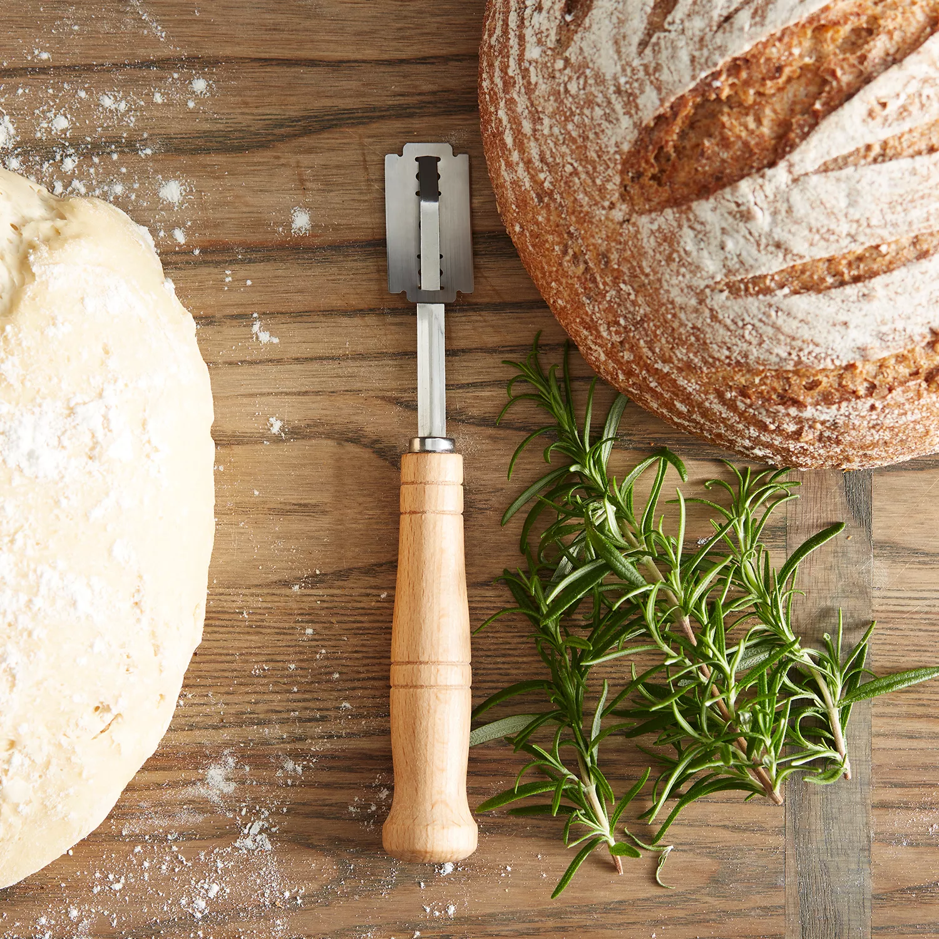
Notes:
lame

